Slide 1

Introduction
Tom Andriola
23.01.2020

Slide 2
How I got to here
CIO (v2.0)
Intrapreneur/GM
General Manager
Business Transformation Leader
CIO
Practice Leader
Alliances
Project Manager
Consultant
Analyst
@Andriola_UC

Slide 3
University of California System (UC)

Slide 4
Role of the CIO @ UC System
Oversee & Lead information technology (IT) function, all locations
  Many don’t comprehend that collectively this covers ~8000 IT staff and ~$1.8B in budgeted labor & spending
High level goals
  Find cost & operational synergies
  Elevate IT conversation to ensure technology & related investment is properly aligned to support & enhance the mission
The burning need: create a “change platform” to:
  Reposition IT to be more mission-relevant
  Shift the spending portfolio
  Unleash trapped value in the system
  Transform the culture
Notes:
% change 6.4% (1.6/25.1) to 5.1% (1.7/33.4)

Slide 5
Discussion:
Cyber-Risk and Cybersecurity
Tom Andriola
23.01.2020

Slide 6
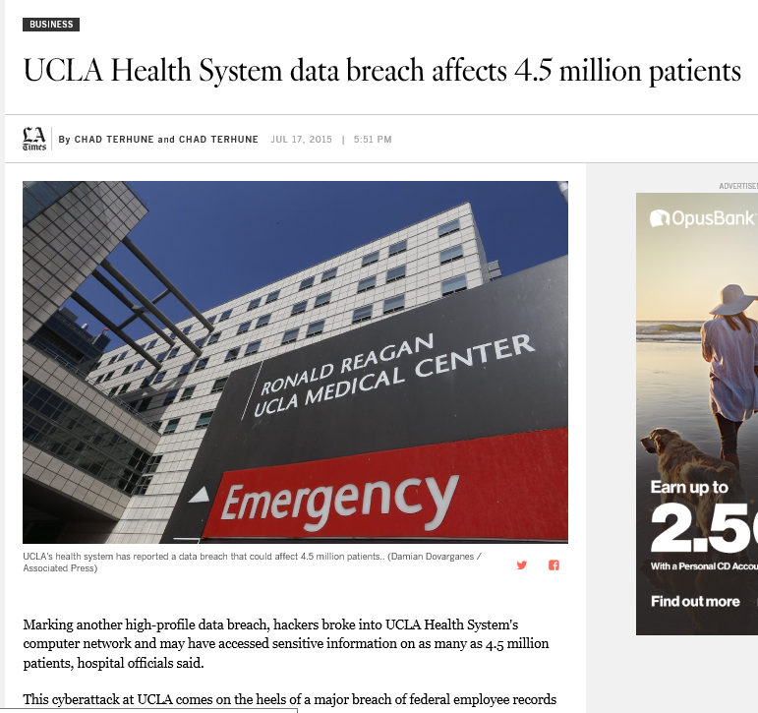
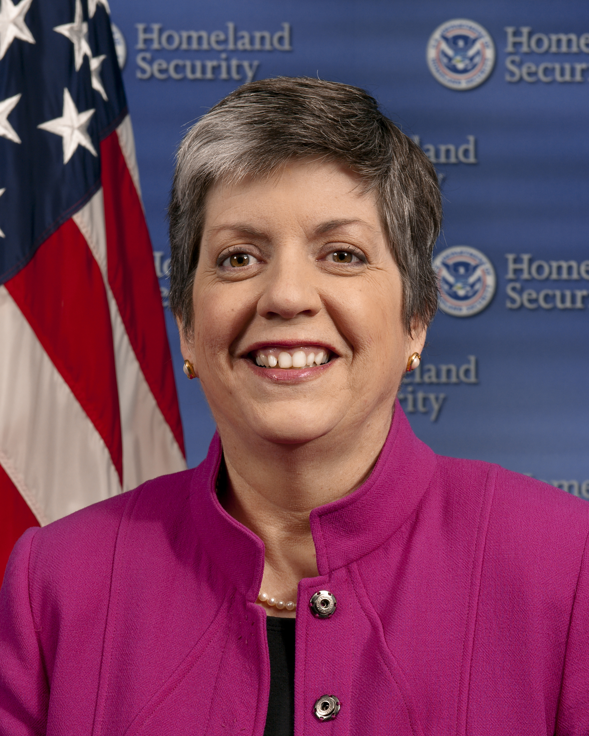
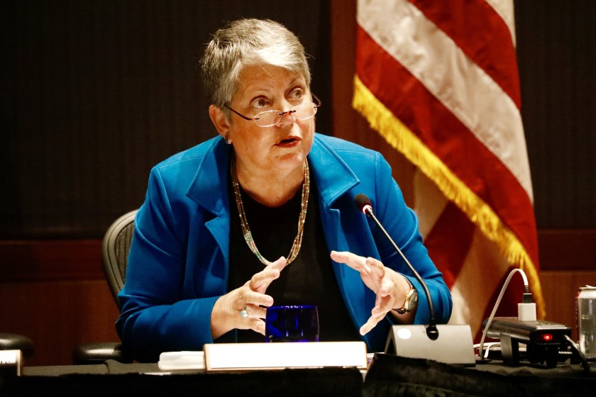

Slide 7
Kickstarting the program & igniting the culture
Common challenges across UC locations
Open environment, e.g., international collaboration, securing end-user devices
Distributed structure e.g., separate networks & teams leading to gaps in visibility
Sensitive, valuable data – e.g., students, patients, faculty IP
Higher Risk
Lower Cost
Lower Maturity
Lower Risk
Higher Cost
Higher Maturity
“How have you created an appropriate level of security that balances our need to protect with our need to run the university and support its mission?”

Slide 8
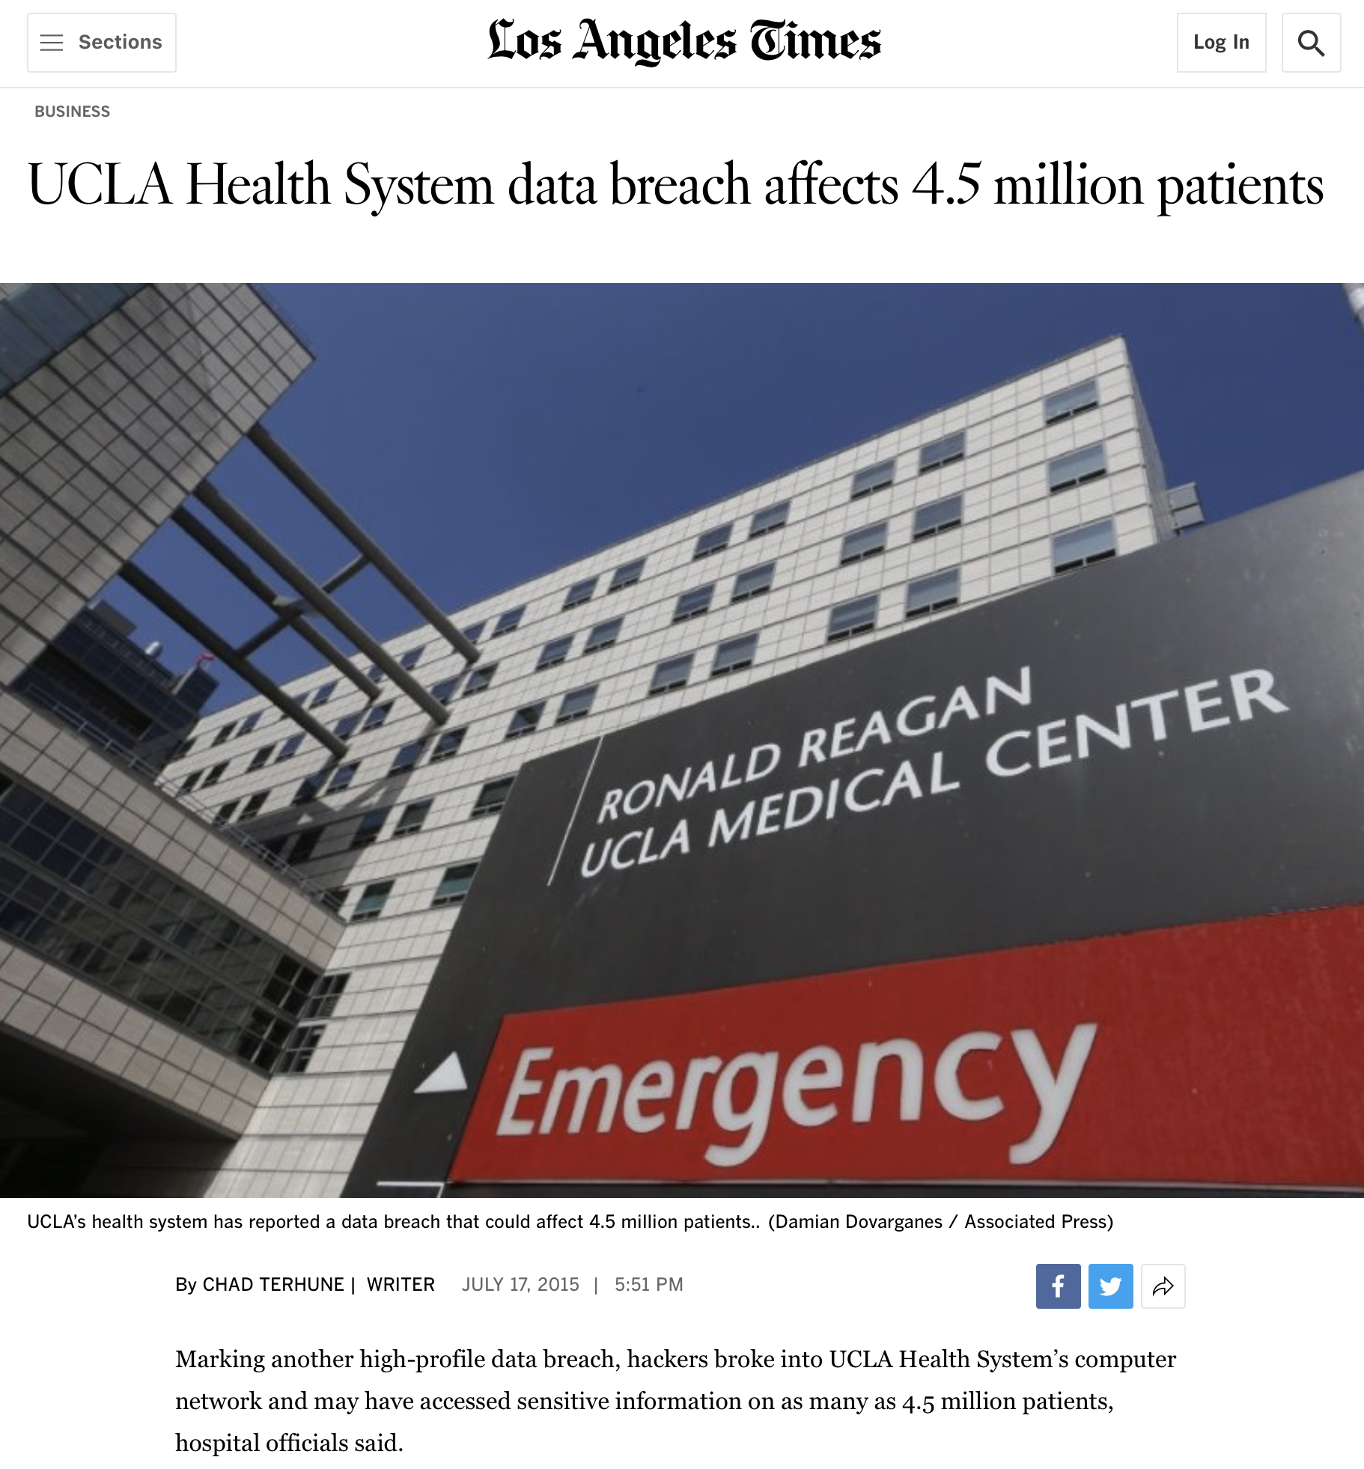
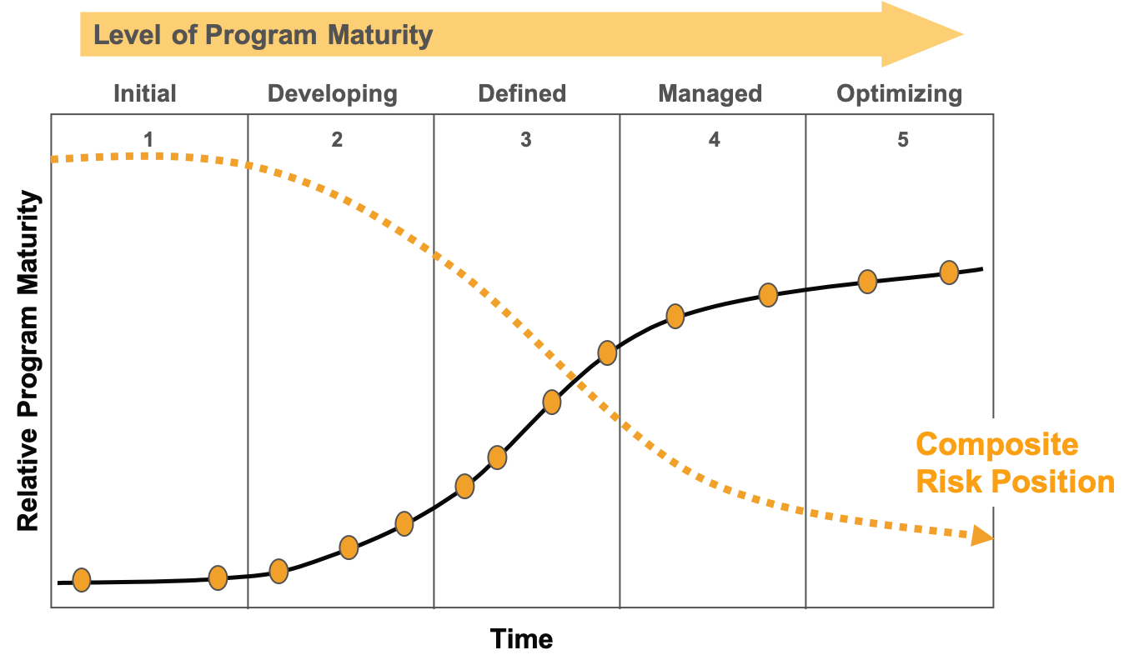
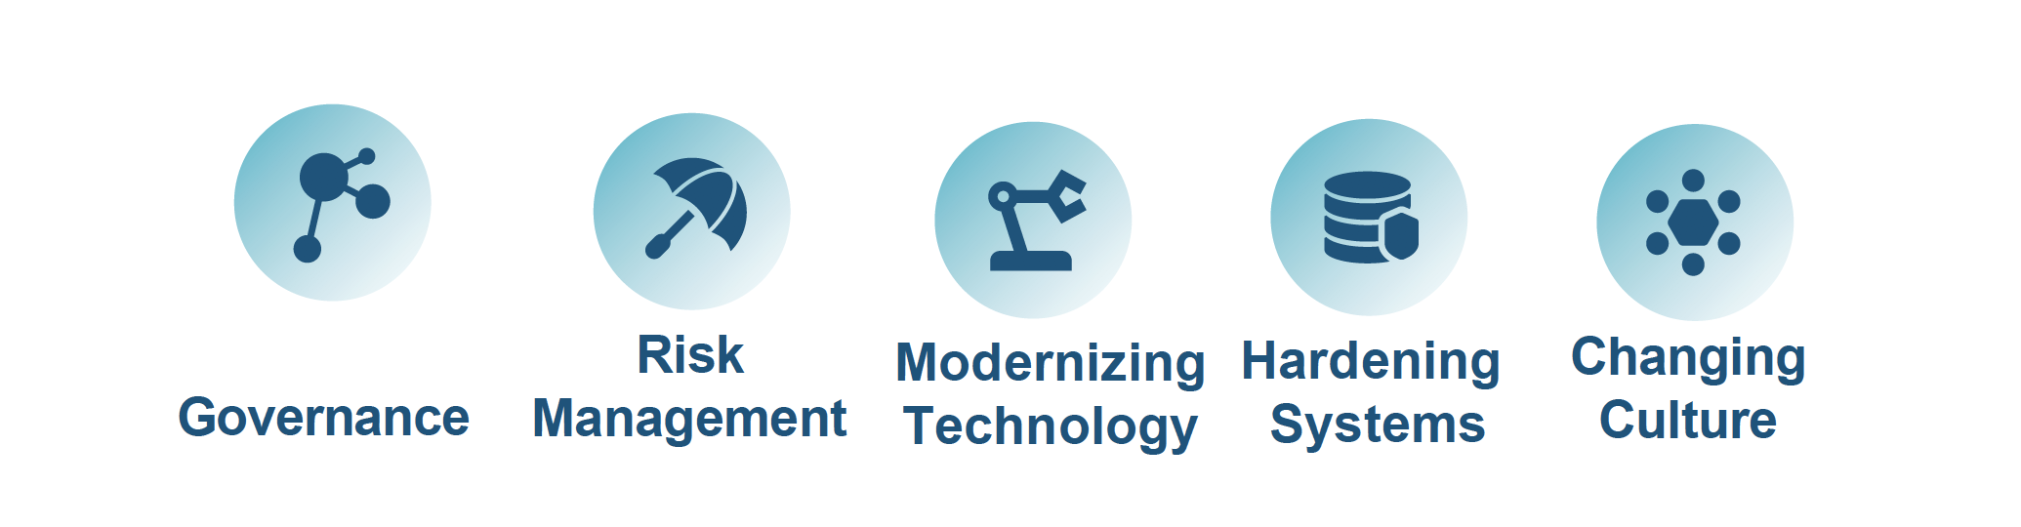
UC’s cyber-risk journey

Slide 9
E.g., Governance
Board of Regents
Office of the President
Academic Senate
Leadership
Council of Chancellors (COC)
Advisory Members
External
Academic Computing
Committee (UCACC)
Advisory Members
Faculty
Cyber-Risk Governance
Committee (CRGC)
Cyber Coordination
Center
CRGC Meetings
* Meet as a group four times per year face-to-face
UC Davis
CRE
UCSF
CRE
UC Berkeley
CRE
UC Santa Cruz
CRE
UCSB
CRE
UC Health
Rep
Faculty
Members
UC Irvine
CRE
UCLA
CRE
UC Riverside
CRE
UC Merced
CRE
UCSD
CRE
ANR
CRE
UCOP
Staff
Cyber Risk Executives (CRE)

Slide 10
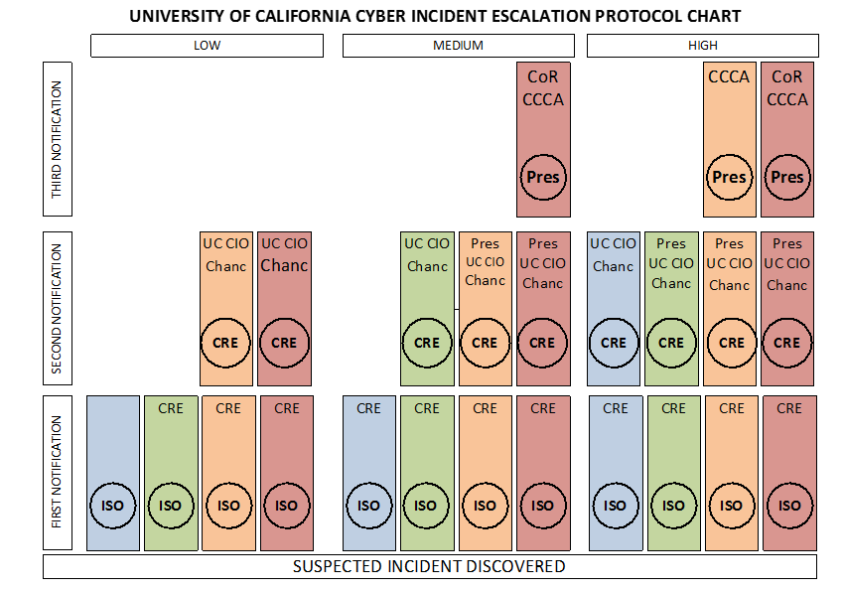
Process for Communication & Escalation
“When in doubt, report”

Slide 11
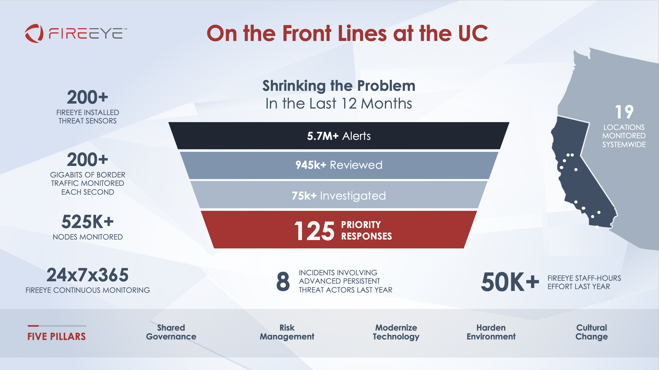
Enterprise Visibility

Slide 12
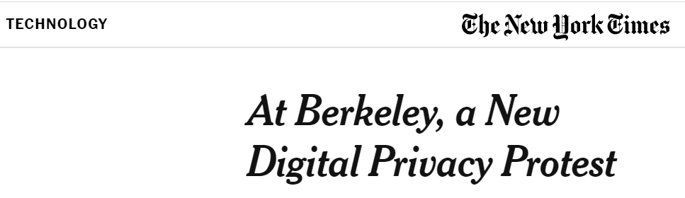
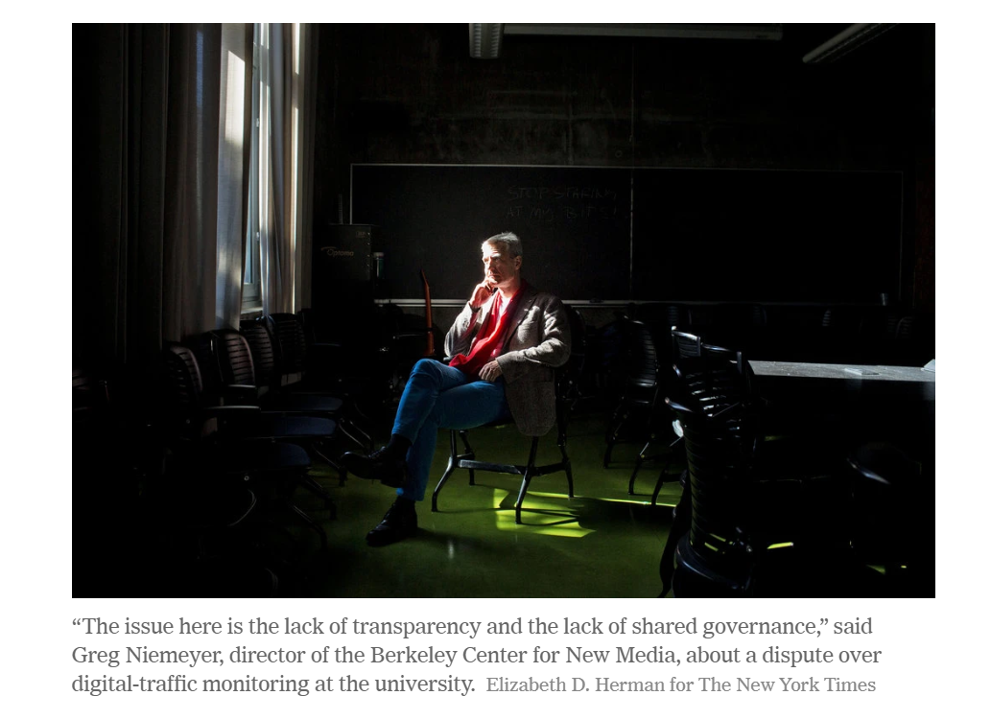
Absorbing the backlash & restoring equilibrium

Slide 13
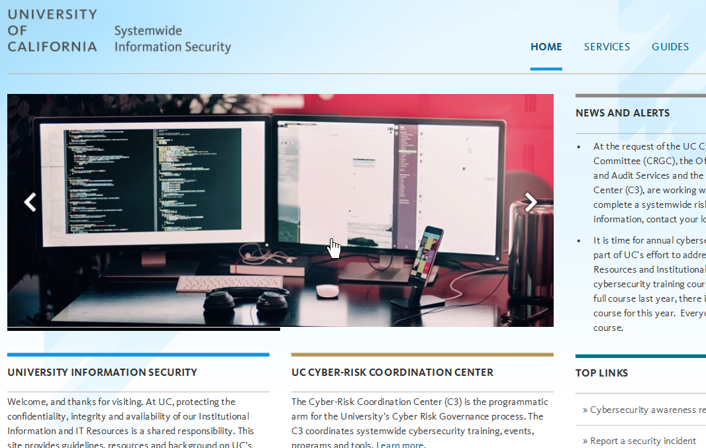
The Cyber Coordination Center (CCC)

Slide 14
Unevenness of capability & adoption
UC locations represented after performing NIST framework assessment
Identify
Protect
Detect
Respond
Recover

Slide 15
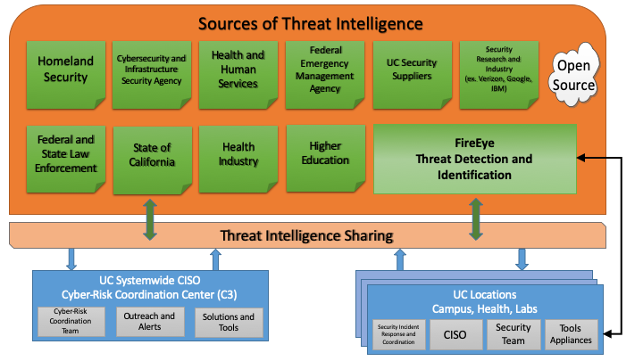
Critical capability: threat intelligence

Slide 16
Attack response to threat intelligence

Slide 17
Example of Threat Intelligence Improvement
Law enforcement provided 5 IOCs, over a two day period
UC took that info to Intelligence Partner, and they provided over 12 IOCs related to the threat – in less than 30 minutes
A subset of Intelligence Partner (“Trust Circle”) provided over 50 IOCs, a detailed analysis, and information from a second law enforcement investigation, in less than 2 hours
This example demonstrates the improved ability to detect, investigate and respond to cyber threats that UC obtains via its threat intelligence network

Slide 18
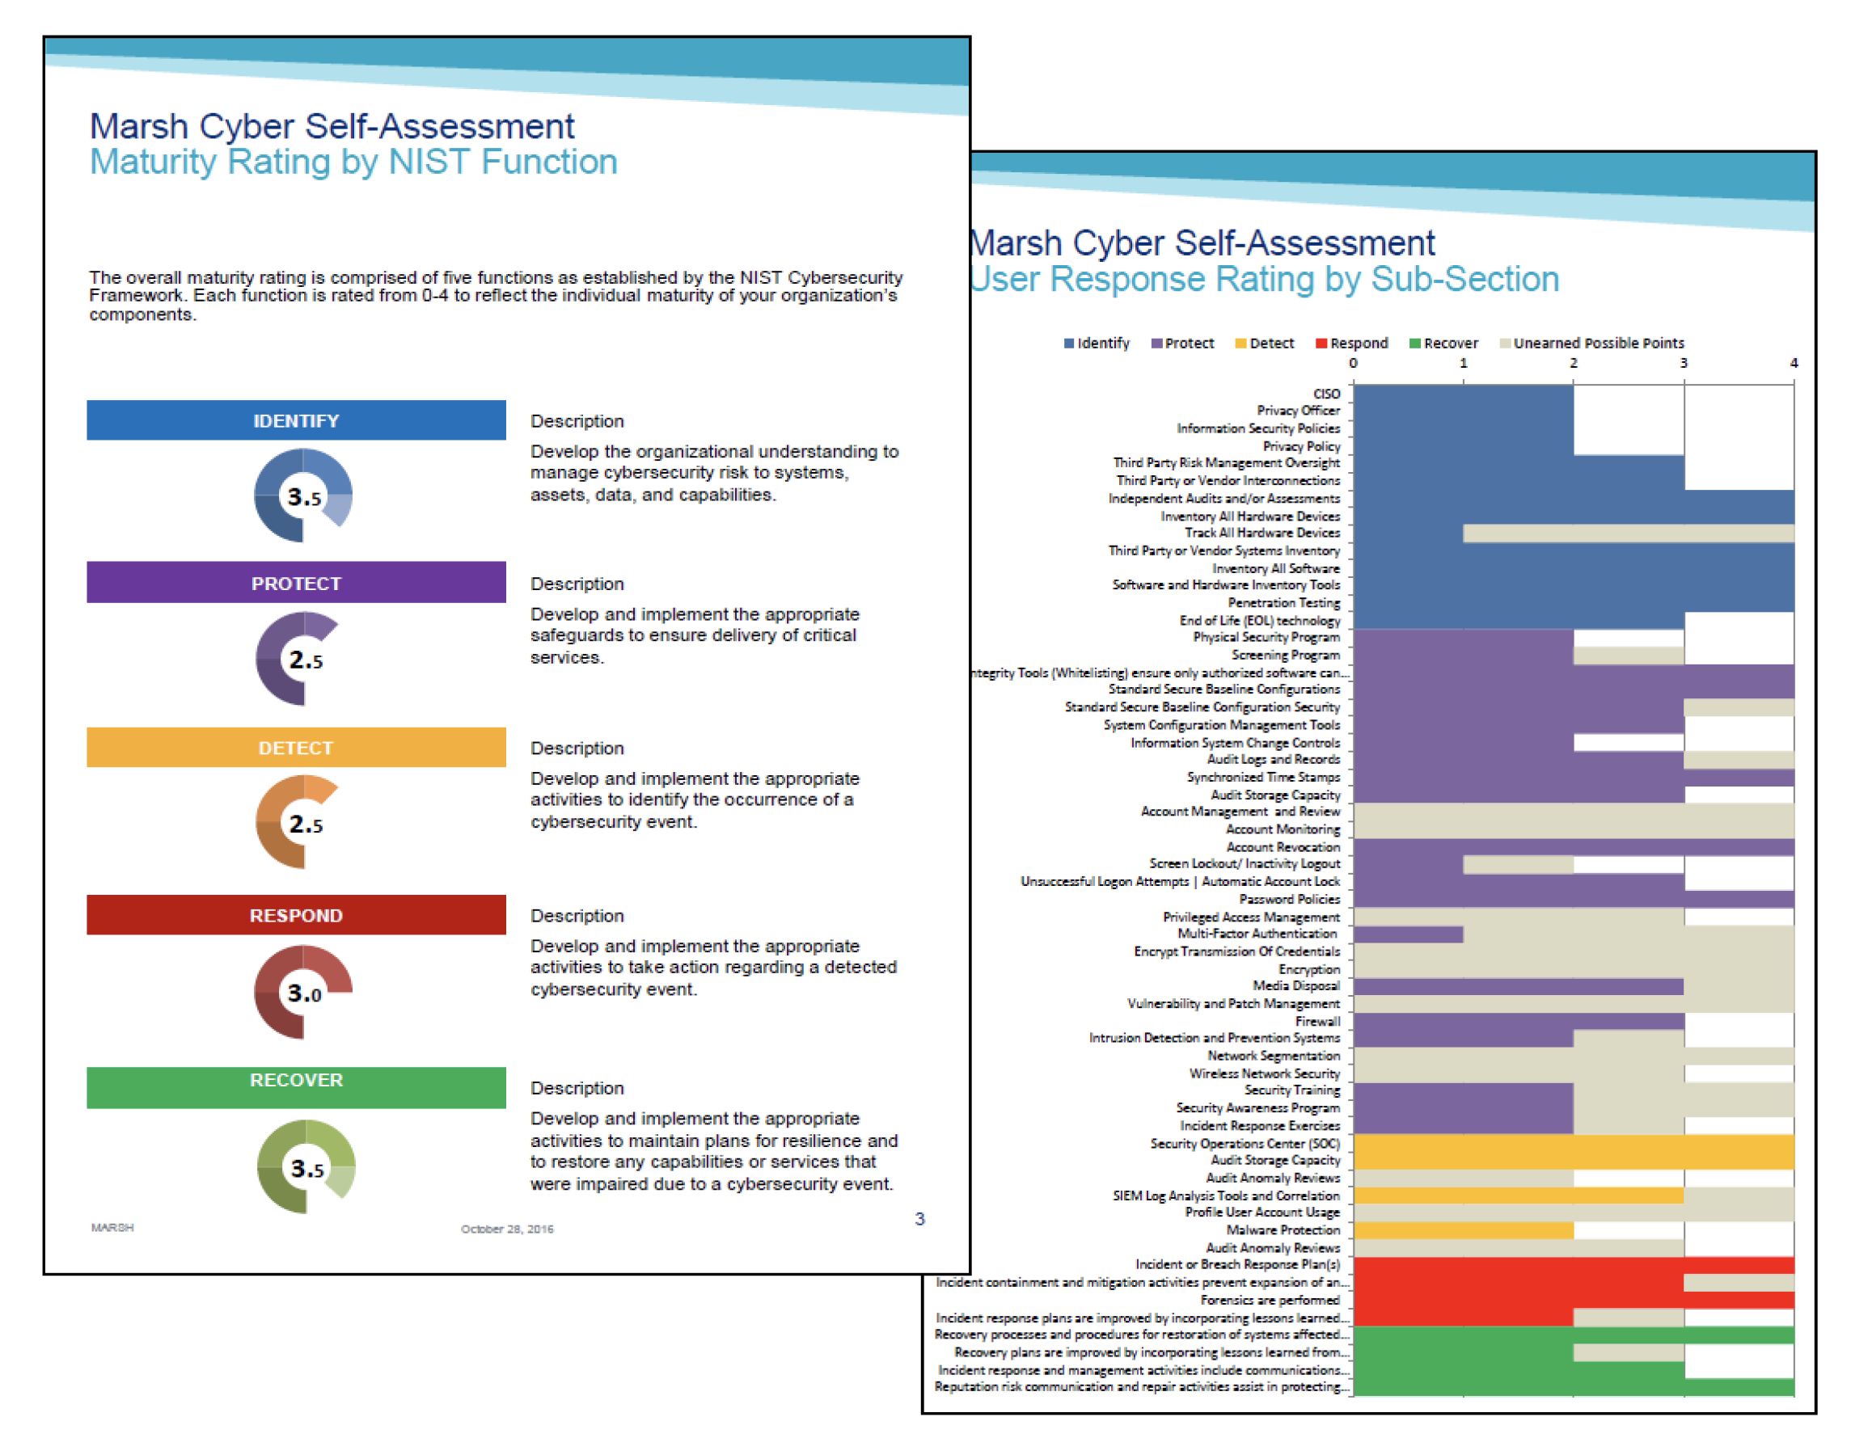
How are we measuring progress & risk?

Slide 19
Cyber Insurance
Conditions Precedent
No Conditions Precedent
$100M
$80M
$45M
$40M
$20M
$20M
$2M
$10M
2010-11
2011-12
2012-13
2013-14
2014-15
2015-16
2016-17
2017-18

Slide 20
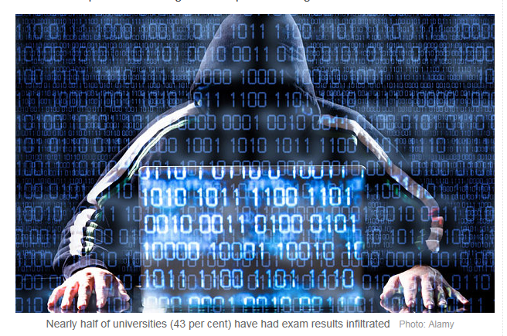
Questions Board should be discussing
How are we measuring the progress on the mechanisms to “protect, detect and respond?”
How do we know our environment is becoming more adaptive and resilient?
Are you working on threats or attacks?
What are the greatest risks & unknowns today?
Is Cyber part of Enterprise Risk Program or an existential threat?

Slide 21
Thank you

Slide 22
Material relating to Board discussion

Slide 23
Our Foundations of a Sustainable Program
Five Core Pillars for our Cyber-Risk Program
Deploy shared governance
Evolve the practice of risk management
Adopt modern technology
Harden the security environment
Create systemwide cultural change
Be coordinated and consistent in our approach

Slide 24
CSF in Plainspeak
Identify – What are your assets?
Protect – Limit the damage - defend
Detect – Know when the bad actor is in
Respond – Hunt the bad actor and expel
Recover – Get back to a normal state

Slide 25
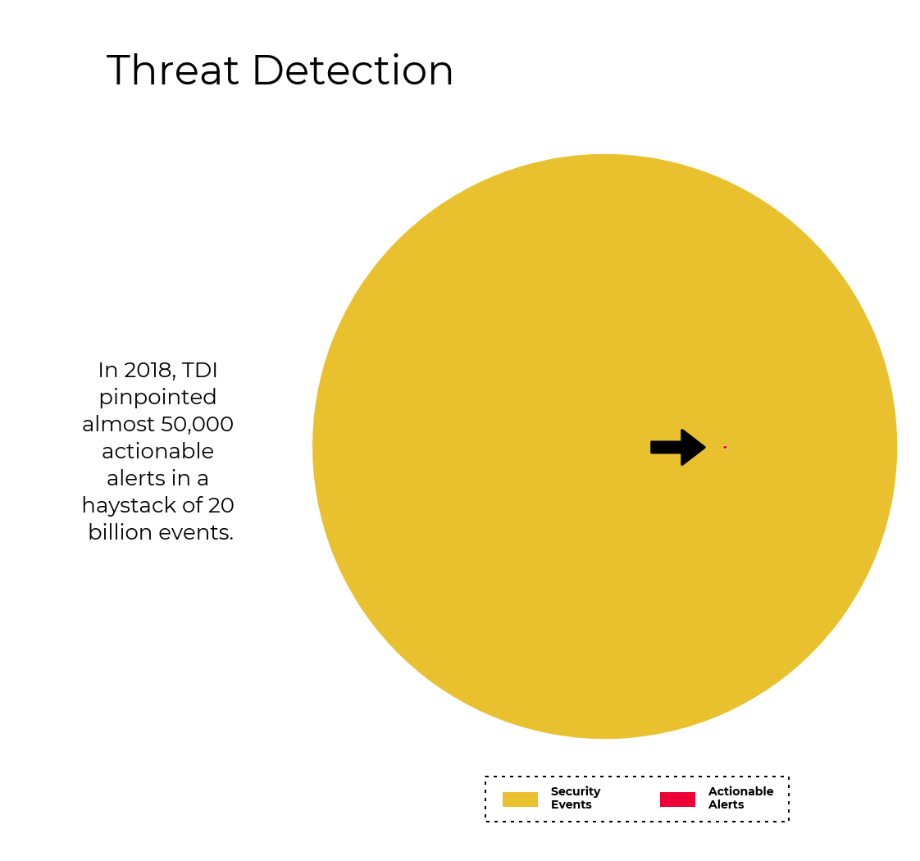

Slide 26
Kickstarting the program & igniting the culture
Common challenges across UC locations
Open environment, e.g., international collaboration, securing end-user devices
Distributed structure e.g., separate networks & teams leading to gaps in visibility
Sensitive, valuable data – e.g., students, patients, faculty IP
Higher Risk
Lower Cost
Lower Maturity
Lower Risk
Higher Cost
Higher Maturity
“How have you created an appropriate level of security that balances our need to protect with our need to run the university and support its mission?”

Slide 27
Key takeaways
We don’t control the threat, but we do control the organization's readiness
Significant progress on improving the university’s capability to protect, detect and respond to bad actors & changing regulatory requirements
Our goal is to build a sustainable program that balances the need to protect against the needs to achieve our mission
Being consistent and coordinated is critical

