Slide 1

The Impact of Technology on Healthcare - 2030 view
Tom Andriola
Vice President & CIO
University of California System
CIO, UC Health
Advisor, Calit2 at UCSD
EIR, CDHI at UCSF
tom.andriola@ucop.edu
@Andriola_UC

Slide 2
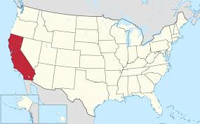
California

Slide 3
University of California System (UC)
University of California
10 campuses and 3 national labs
~220,000 employees, ~275,000 students
UC Health
6 health systems, regionally across state
18 health professional schools (6 med schools)
Train ~50% medical students & residents in state
~$2 billion healthcare-related funding
$11.4 billion clinical operating revenue
5000 faculty physicians, 12000 nurses
UCSF and UCLA are in US News top 10
5 NCI Comprehensive Cancer Centers, 5 NIH CTSA

Slide 4
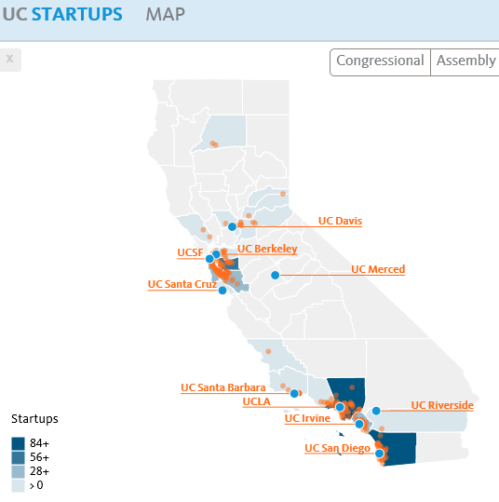
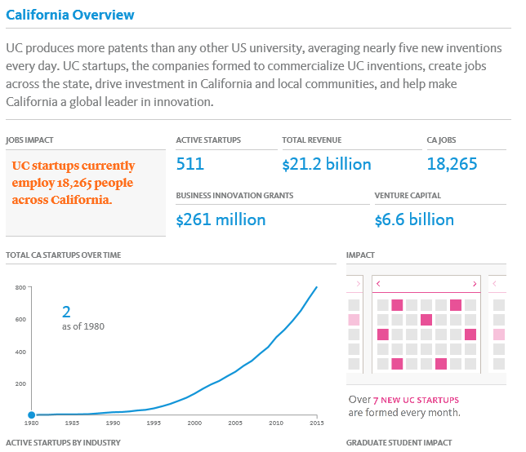
Research Excellence & Innovation

Slide 5





Innovation Ecosystem
Talent
Ideas
Technical
Talent
Scientific
Insight
Entrepreneurial /
Business Talent
Market /
Application Insight
Community
Access to Capital
Commercial Partners
Go-to-Market /
Supply-Chain
Facilities /
Infrastructure
Government
& Policy
Resources
Collaborators
© 2018 Insight & Execution
used with permission

Slide 6
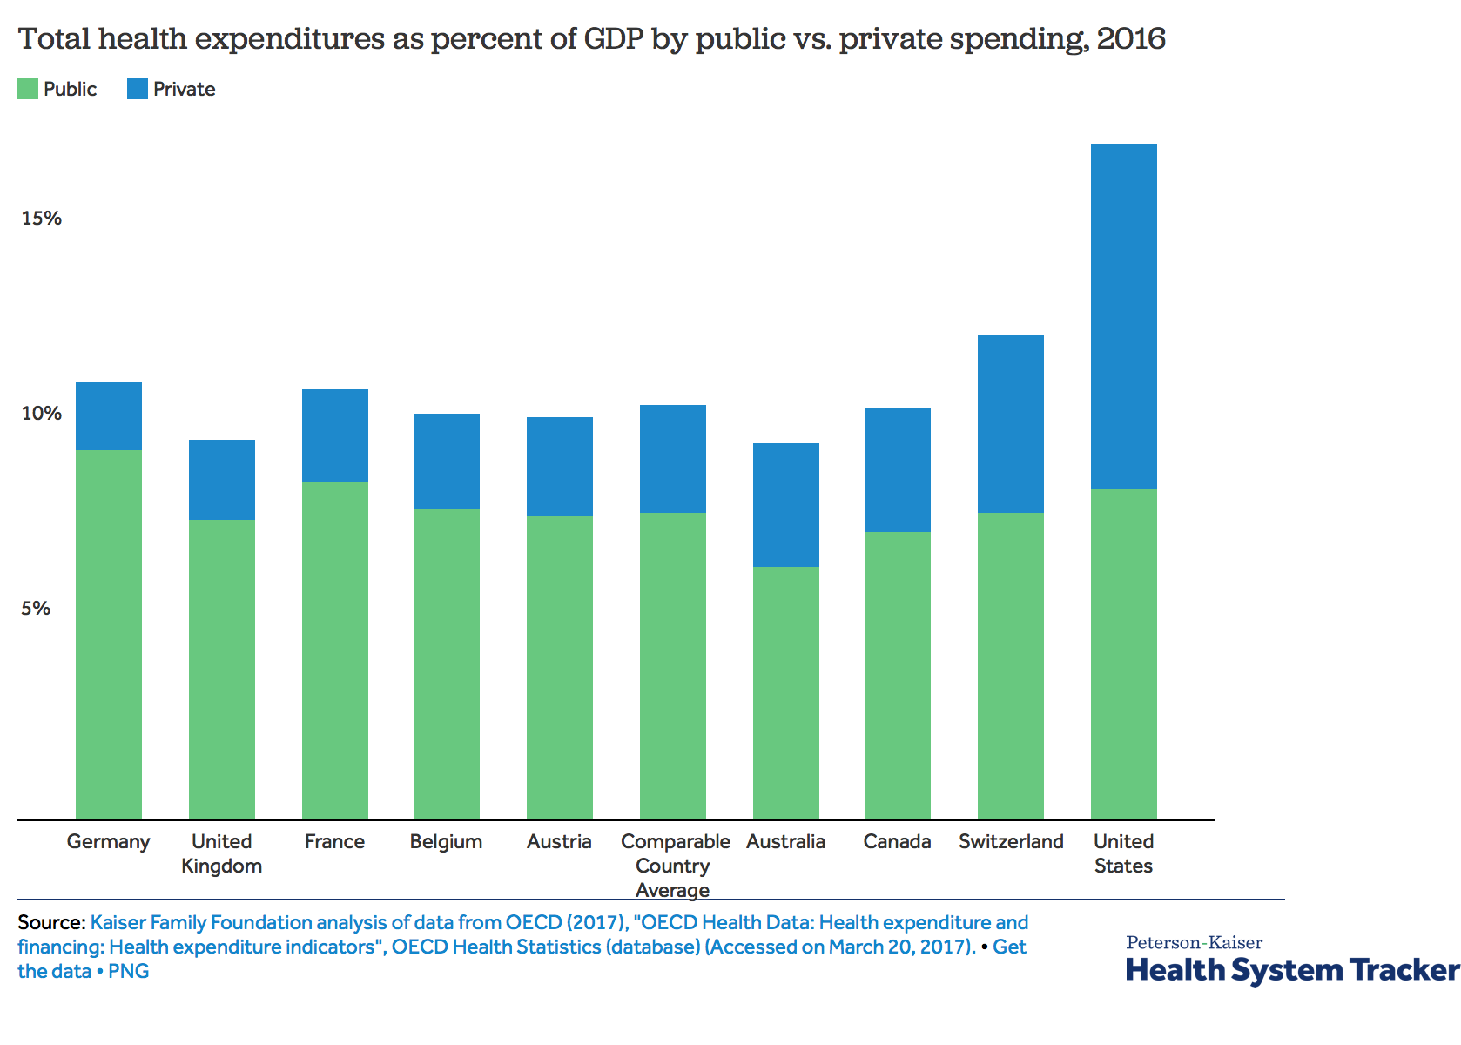
Challenges to the Health Ecosystem
$3.65T (2018)
18% GDP

Slide 7
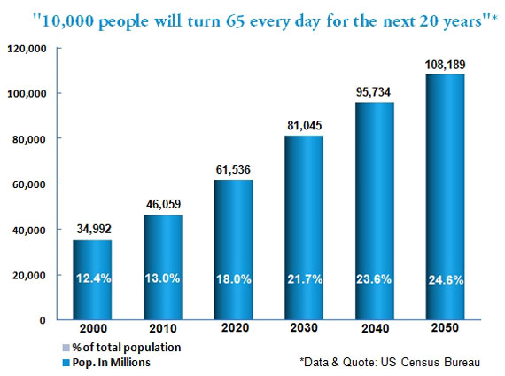
Challenges to the Health Ecosystem

Slide 8
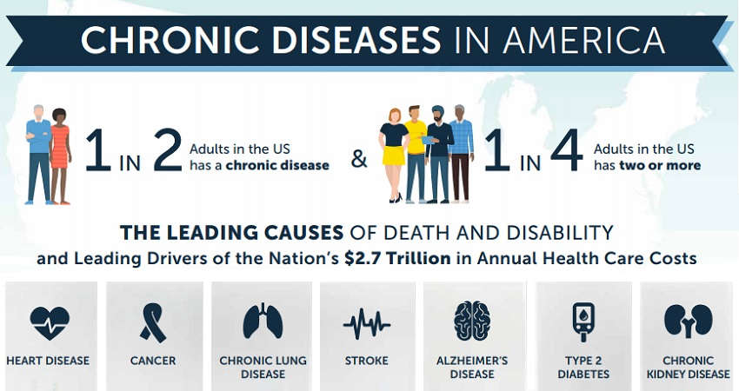
Challenges to the Health Ecosystem

Slide 9
Challenges to the Health Ecosystem
Source: United States Congressional Budget Office, 2017

Slide 10
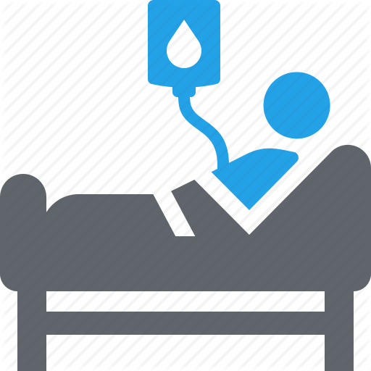



Unsustainable

Slide 11
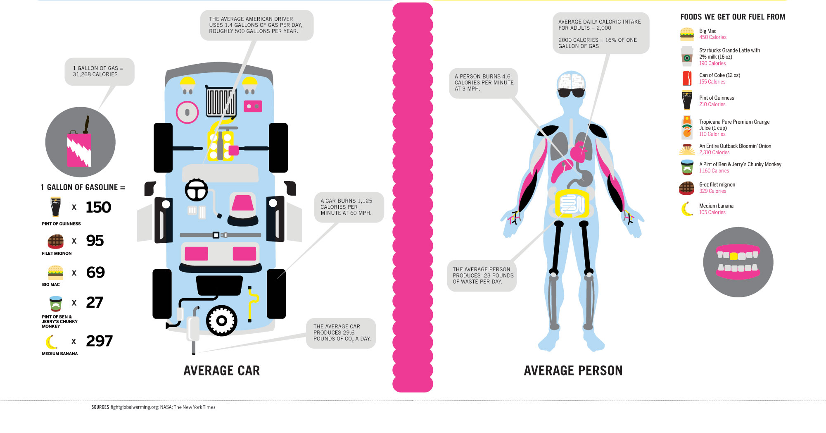
Q: Are we even doing a good job?

Slide 12
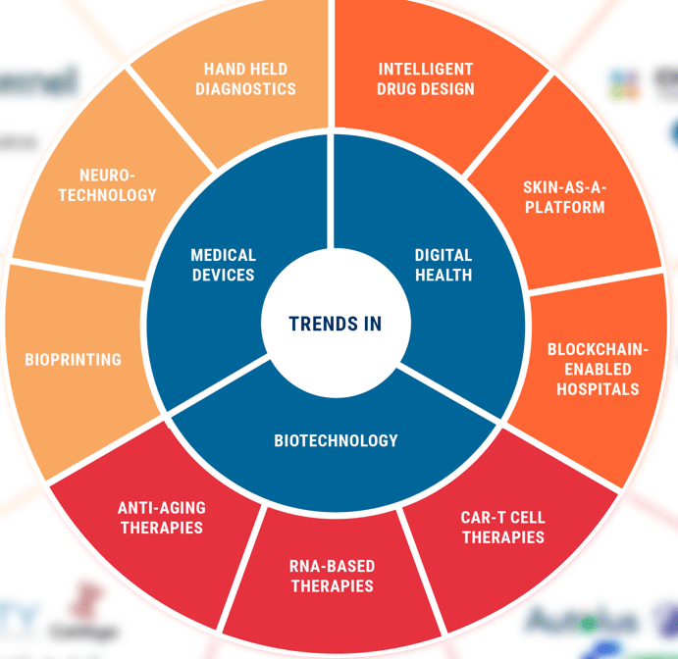
5/24/2019
12
Dramatic Innovation
Technology
Enablement
Consumerization
Scientific
Discovery
Computing
Capabilities

Slide 13
Healthcare has emerged as data-intensive

Slide 14
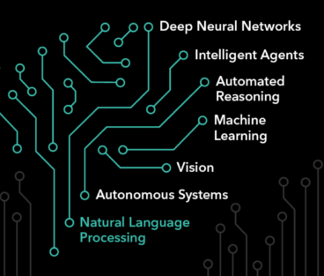



Q: Does it result in best health outcomes?
Recognition
Diagnosis
Prediction
Trajectory
Optimization
Intervention

Slide 15
Power of using data strategically

Slide 16
Medication Strategies for T2D Patients
UCSF: Atul Butte & Tom Peterson

Slide 17
Medication Strategies for T2D Patients
UCSF: Atul Butte & Tom Peterson

Slide 18
Medication Strategies for T2D Patients
UCSF: Atul Butte & Tom Peterson

Slide 19
Medication Strategies for T2D Patients
1,640 Unique Medication Trajectories for Treating T2D
UCSF: Atul Butte & Tom Peterson

Slide 20
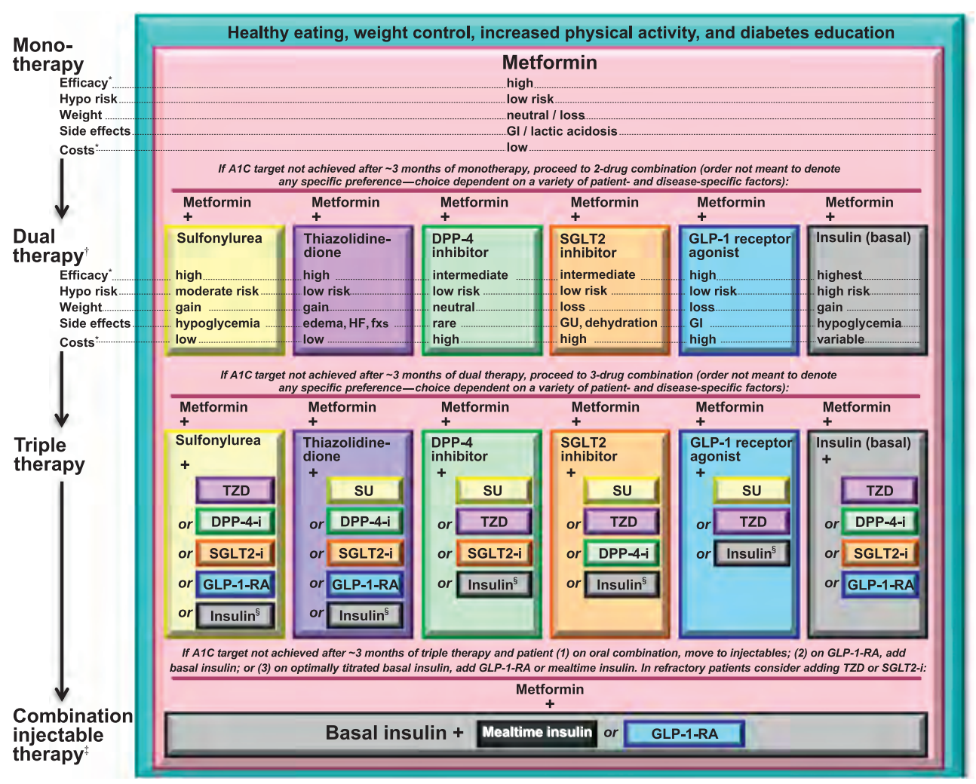
Asking the question why
Source: American Diabetes Association Standards of Medical Care in Diabetes (2016)

Slide 21
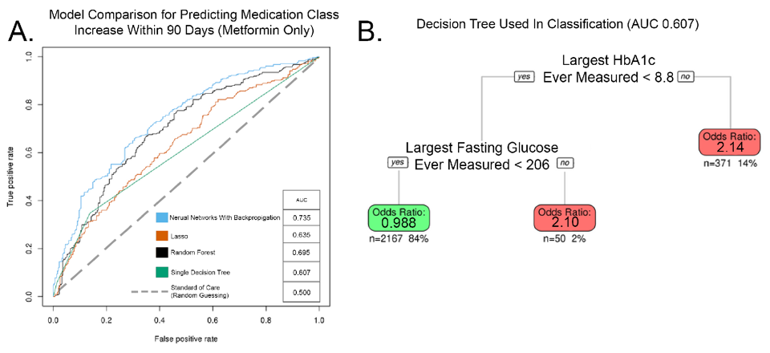
Why can’t we do better?
Performance for Predicting Medication Class Increase Within 90 Days from Metformin
UCSF: Atul Butte & Tom Peterson

Slide 22
Power of using data strategically

Slide 23
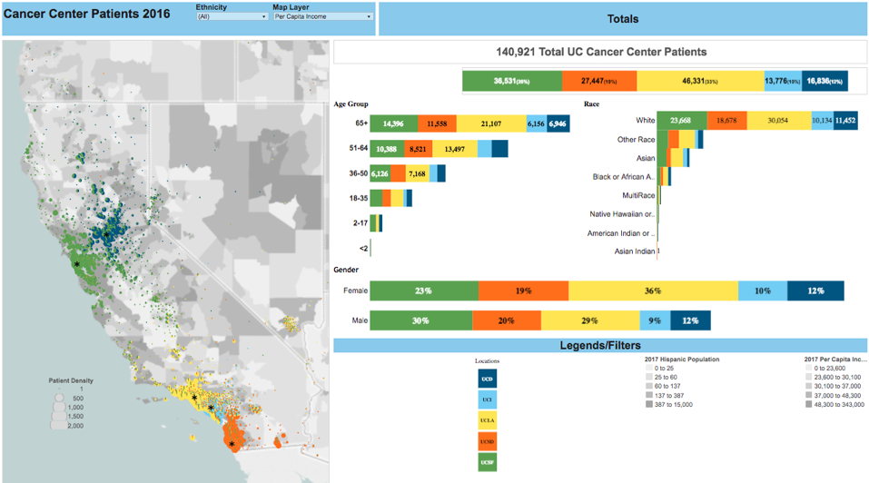
What we know about our cancer patients

Slide 24
Evolution of genetics into personalized medicine

Slide 25
Evolution of genetics into personalized medicine

Slide 26
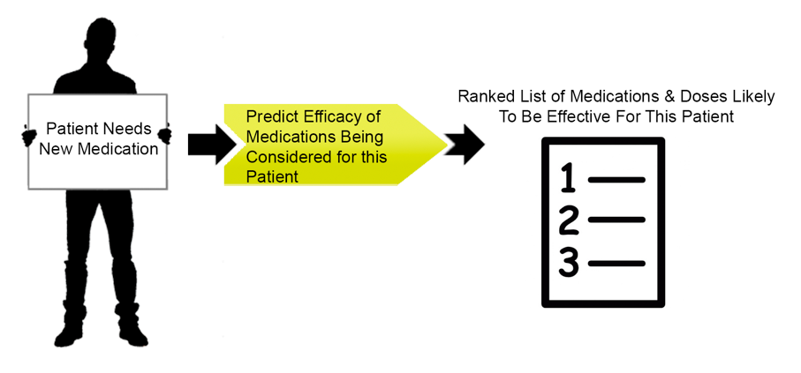
Precision Medicine In Practice

Slide 27

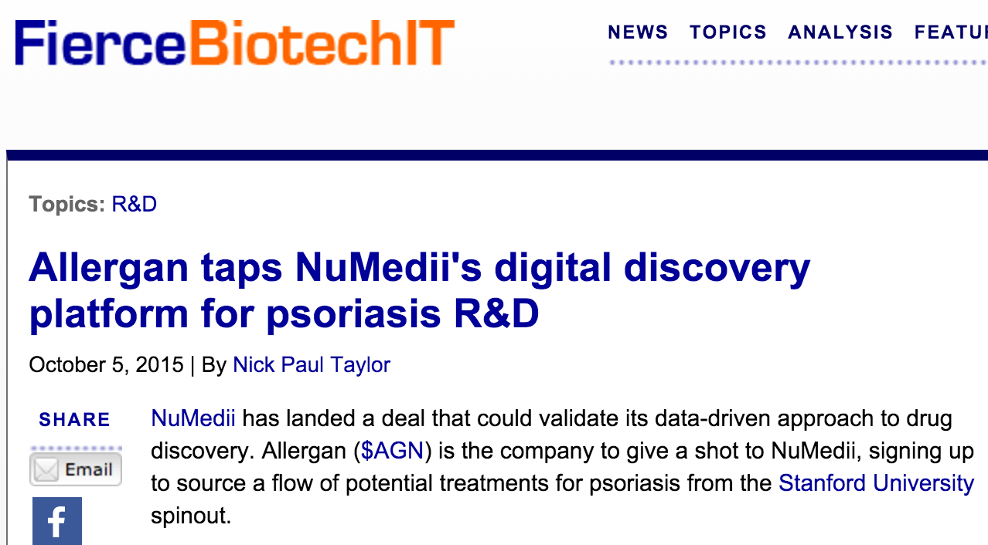
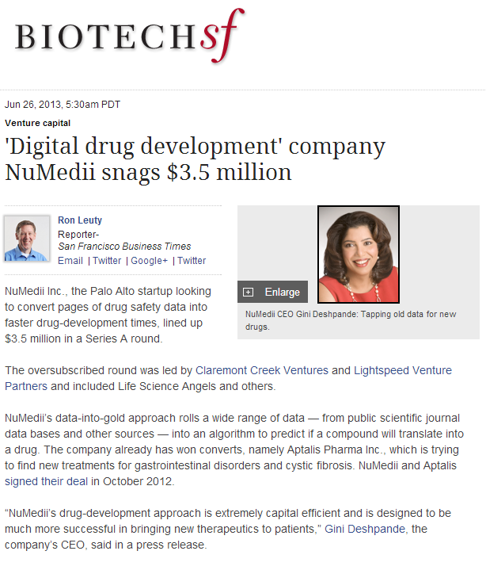
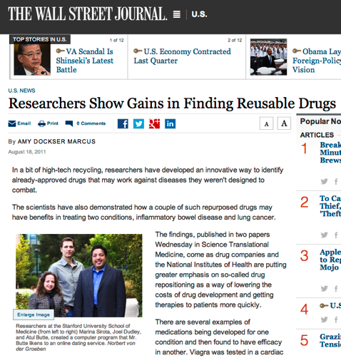
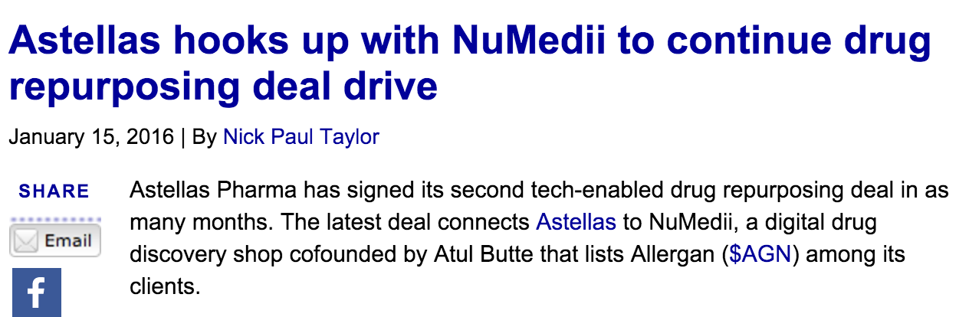
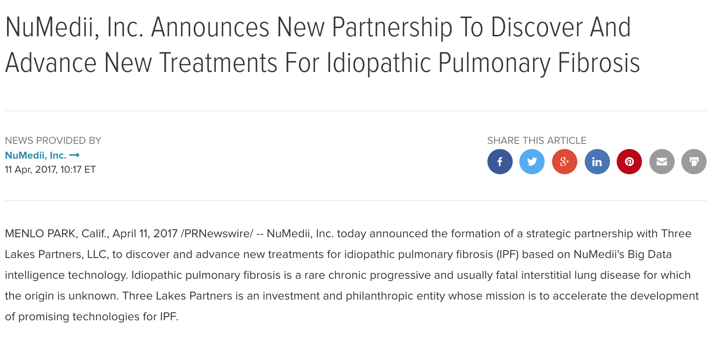
E.g., Digital Drug Development
Digital Therapeutics
NIH funding
Claremont Creek, Lightspeed ($3.5 million)
Need more drugs for more diseases
Public big data available
Data analyzed, method designed
Company launched, ARRA, StartX, Stanford license,
first deal
@NuMedii

Slide 28


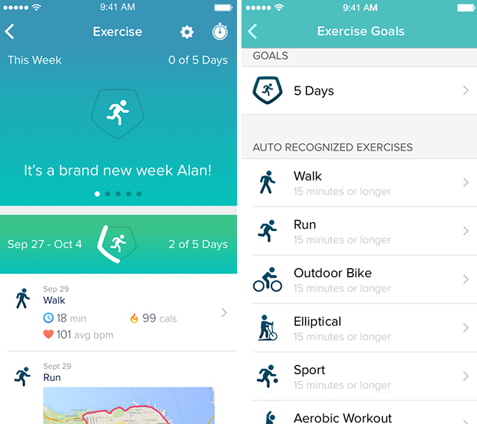
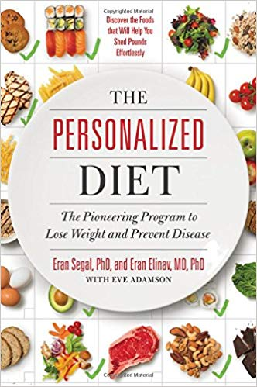
Driven by science, technology, data and patient choice
Consumer wants to be healthy

Slide 29
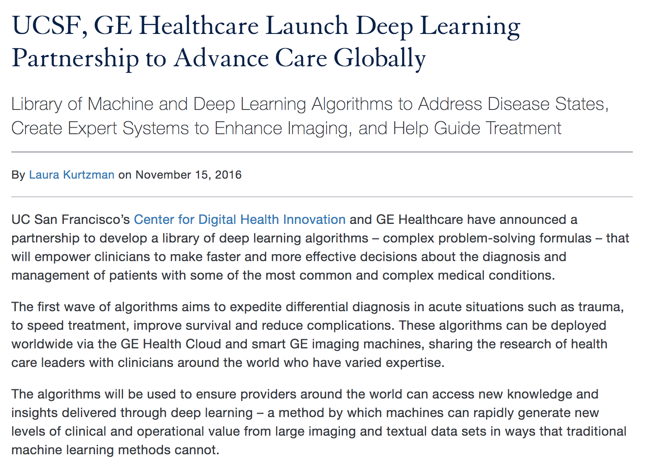
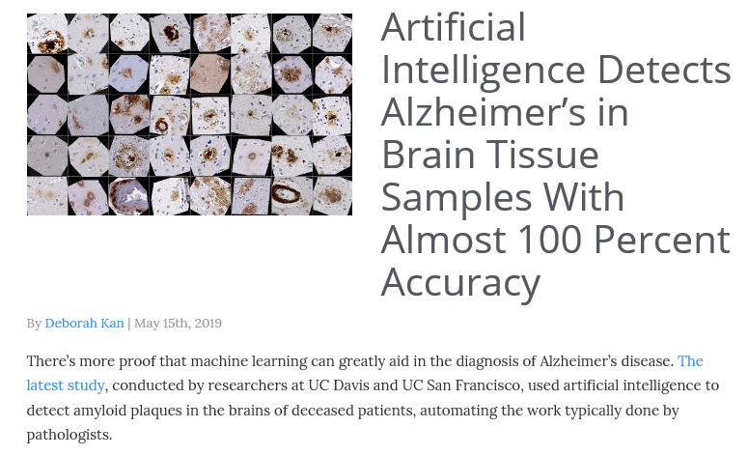
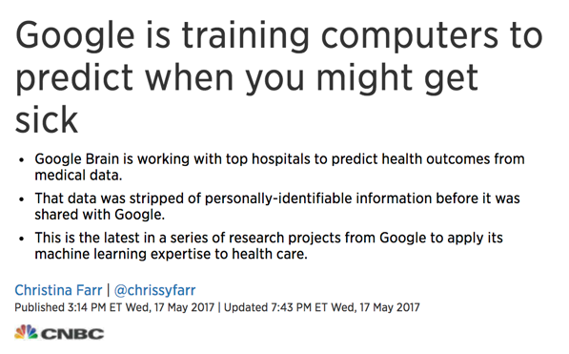
https://www.beingpatient.com/artificial-intelligence-detects-alzheimers-in-brain-tissue/
Notes:
You asked us to talk about our real experiences
UCSF GE
Chest X-ray processing
Commonly missed features

Slide 30
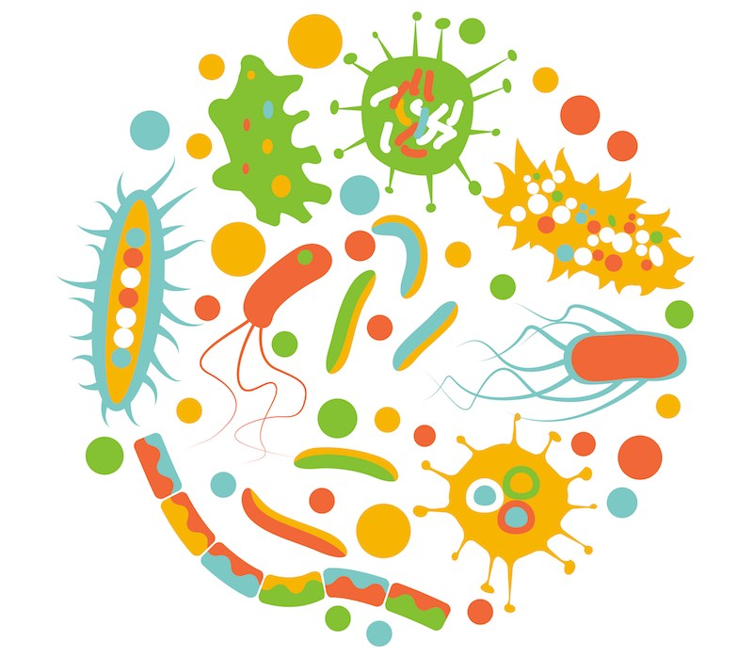
The Microbiome

Slide 31
The Microbiome
Health
Systems
Food
Systems
Nano Tech
Data Science
3D Printing
Artificial
Intelligence
Computational
Sciences
5G
Sustainability

Slide 32
Consumer Empowerment

Slide 33
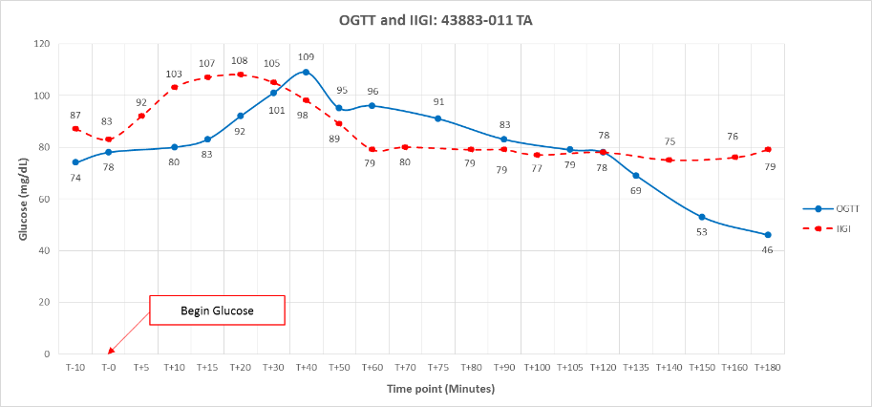
Consumer Awareness & Education

Slide 34
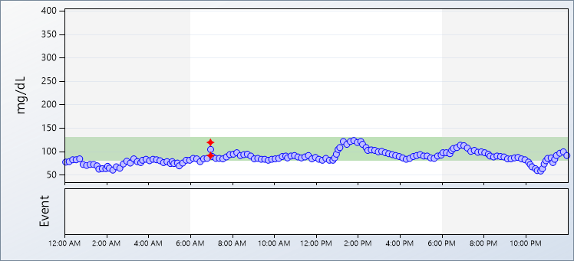
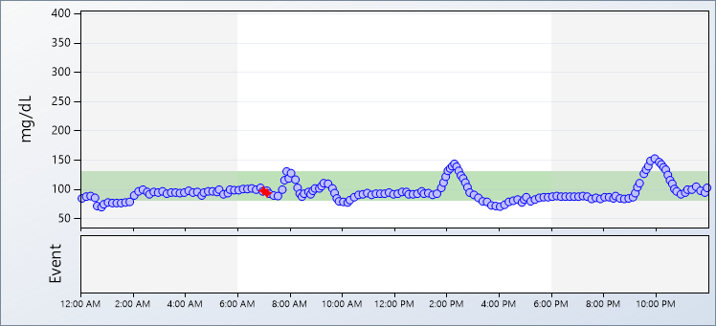
 | Thursday, February 14, 2019 7:06 AM Coffee, Prepared From Grounds 7:06 AM Soy Milk, Plain or Original, 7:07 AM Stevia In The Raw Packets 7:07 AM Banana, Fresh 12:23 PM Chicken Breast, 12:23 PM Tossed Salad, Plain, without Dressing 12:23 PM Mushrooms, Cooked from Fresh 12:24 PM Quinoa, Cooked 1:25 PM Dole, mixed fruit, in juice, individual cup 1:25 PM Chocolate Chip Cookies, Bakery 5:27 PM Basmati Rice, Cooked in Unsalted Water 5:27 PM Brussels Sprouts, Cooked from Fresh 5:28 PM Beets, raw or blanched, 5:28 PM Avocado, Black Skin, California Type 5:28 PM Edamame, Green or Immature, 5:29 PM Endive, Curly, Raw 5:29 PM Mung Bean Sprouts, Raw 6:44 PM Peet's Coffee & Tea, iced mocha, caffe, with soy milk,
 | Friday, February 15, 2019 7:20 AM Starbucks, Caffe Latte, Soy 7:30 AM Apple, Fresh, With Skin 7:25 AM Muffins, Blueberry, Homemade 1:39 PM Organics, Mixed Baby Spring Greens, Fresh 1:39 PM Beets, Raw 1:53 PM Brie Cheese 2:44 PM Gluten Free Bread, White 2:45 PM Coffee, Prepared From Grounds 2:45 PM Half and Half 2:46 PM Stevia In The Raw Packets 8:50 PM Lettuce, Iceberg 8:50 PM Tomato Raw, Includes Cherry, Grape, Roma 8:51 PM Chicken Breast, Skin Removed Before Cooking 8:51 PM Woodstock, pretzels, yogurt covered
34

Slide 35
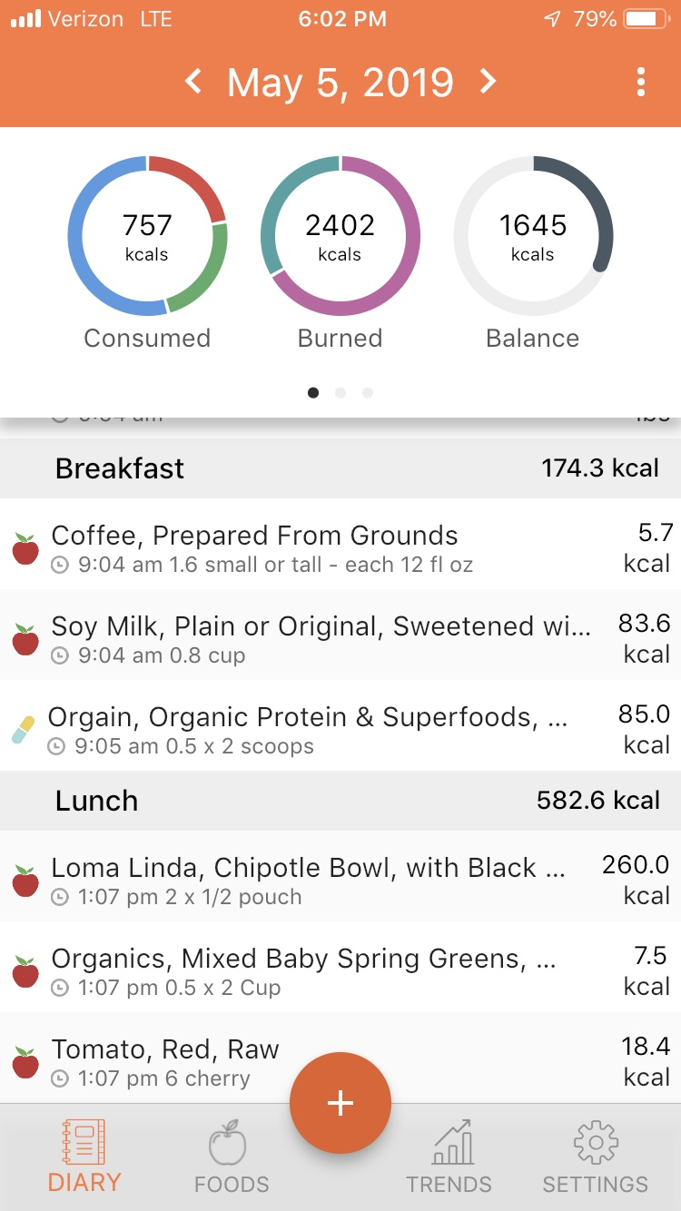
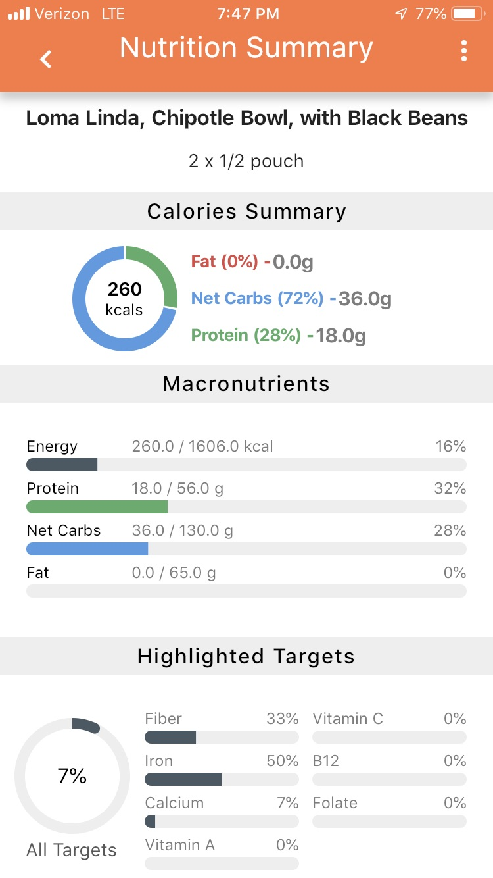

Slide 36
Mixing Scientific Disciplines
Food Systems
Health Systems

Slide 37
Mixing Ecosystems
Central Valley
Silicon Valley
Talent
Ideas
Technical
Talent
Scientific
Insight
Entrepreneurial /
Business Talent
Market /
Application Insight
Community
Access to Capital
Commercial Partners
Go-to-Market /
Supply-Chain
Facilities /
Infrastructure
Government
& Policy
Resources
Collaborators
© 2018 Insight & Execution
used with permission
Sick Care ➔ Health Care

Slide 38

Food as Therapy – Different Paradigm
Current State
Generalized guidelines promote non specific “better health”
Standardized, 2D guidelines for a few diseases (i.e., diabetes)
Nutrition is typically “non-medical” and viewed as a health and wellness lifestyle factor
Future State
Phenotypic guidelines provided to prevent disease based on individual Digital Fingerprints
Personalized nutritional therapy to prevent and treat most diseases
Nutrition is holistic part of medicine and health and interrelated with Enhanced Patient Evidence

Slide 39
Food as Therapy – Different Paradigm
Differentiated Approaches | Data-Driven Insights & Innovations
Enhanced Patient Data Set | Longitudinal, integrated, state-of-the art multimodal health and medical data on individuals
Dynamic Ontologies | Cross-industry defining, process based ontologies.
Digital Fingerprint | Consumer phenotypes utilized to identify and validate personalize nutritional therapy options.
Digital Biomarkers | Predictive metrics for defining the correct personalized treatment pathway
Nutritional Therapeutic Validation | Validation path provided from/to – lab, model, test bed, pilot, food option, table, stomach

Slide 40
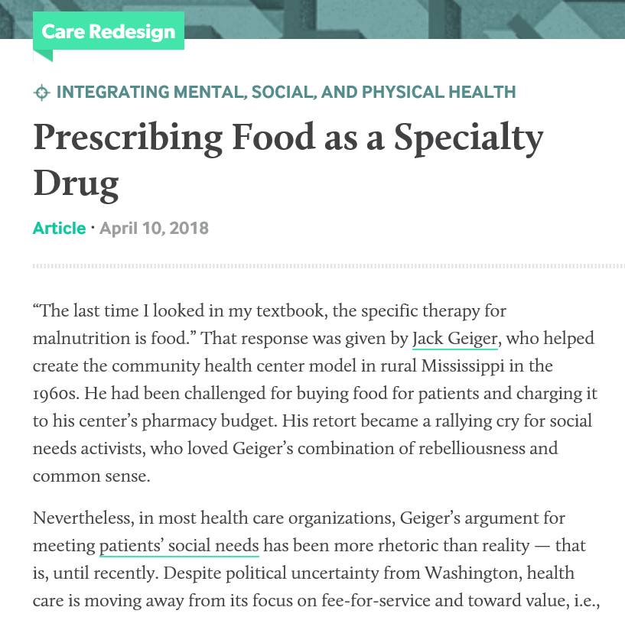

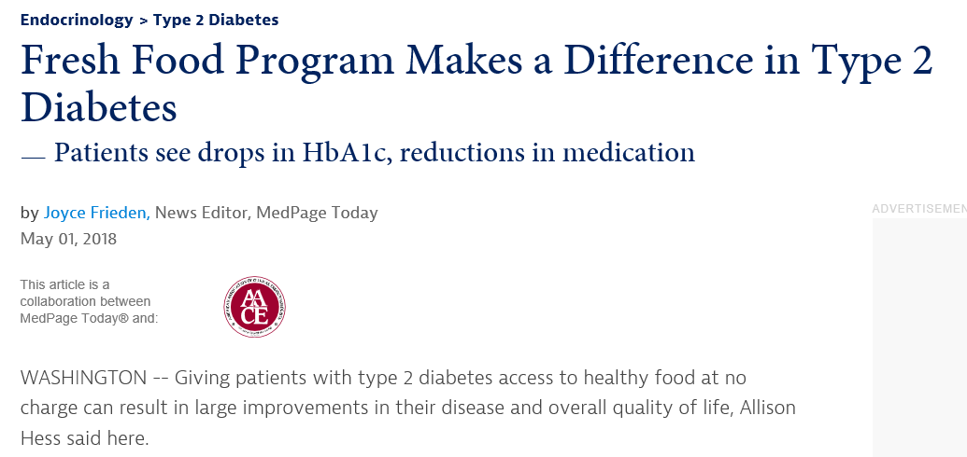
Food as Therapy – Proof Points

Slide 41
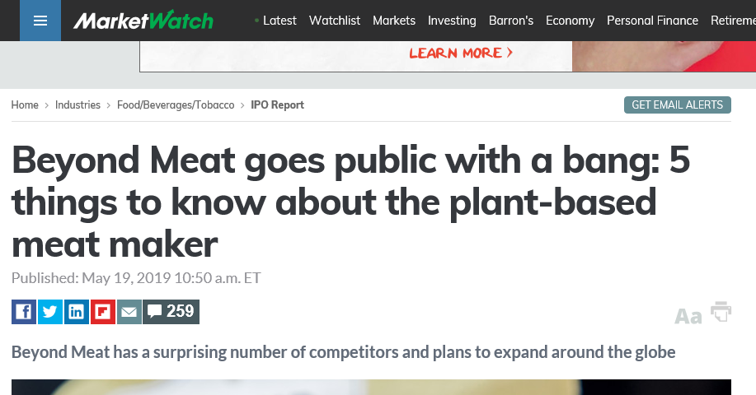
Food as Therapy – Proof Points

Slide 42
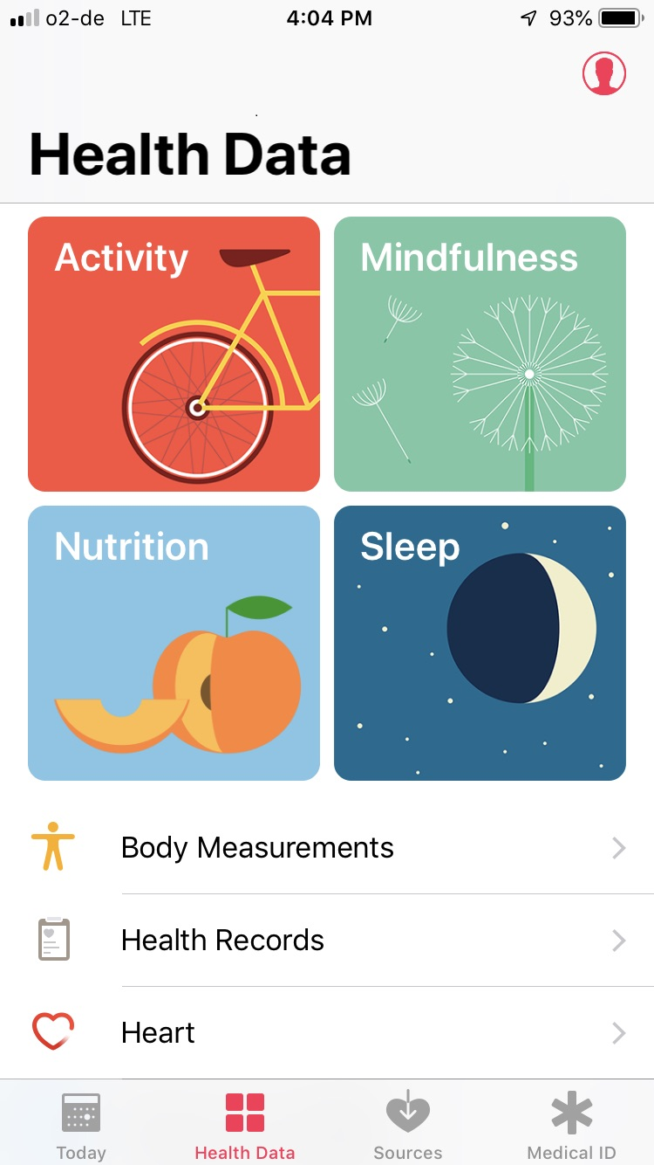
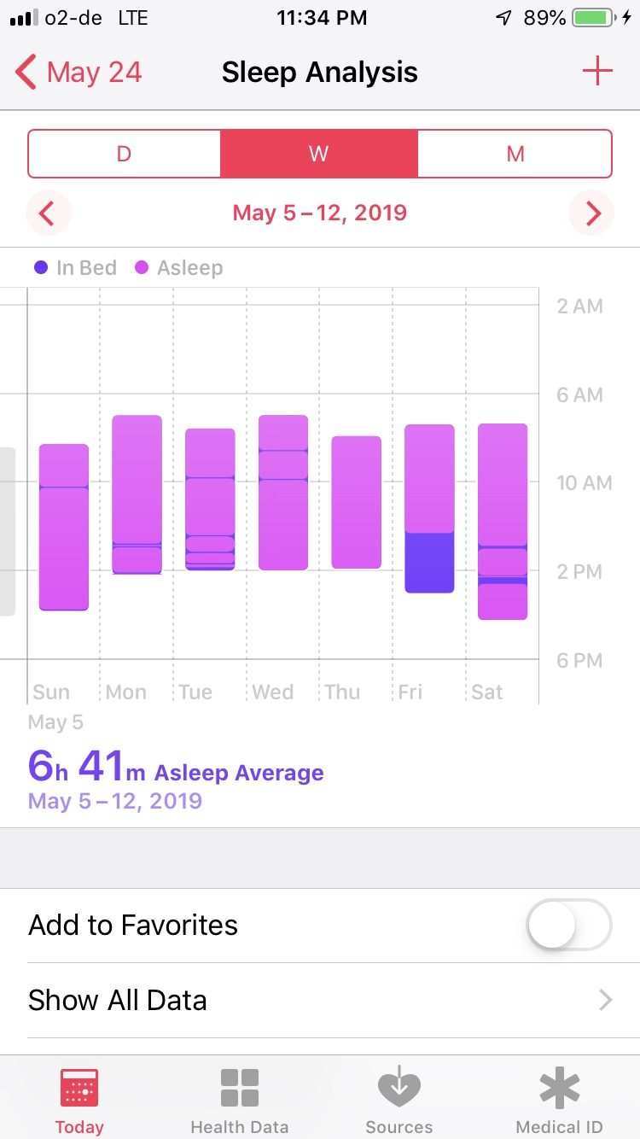
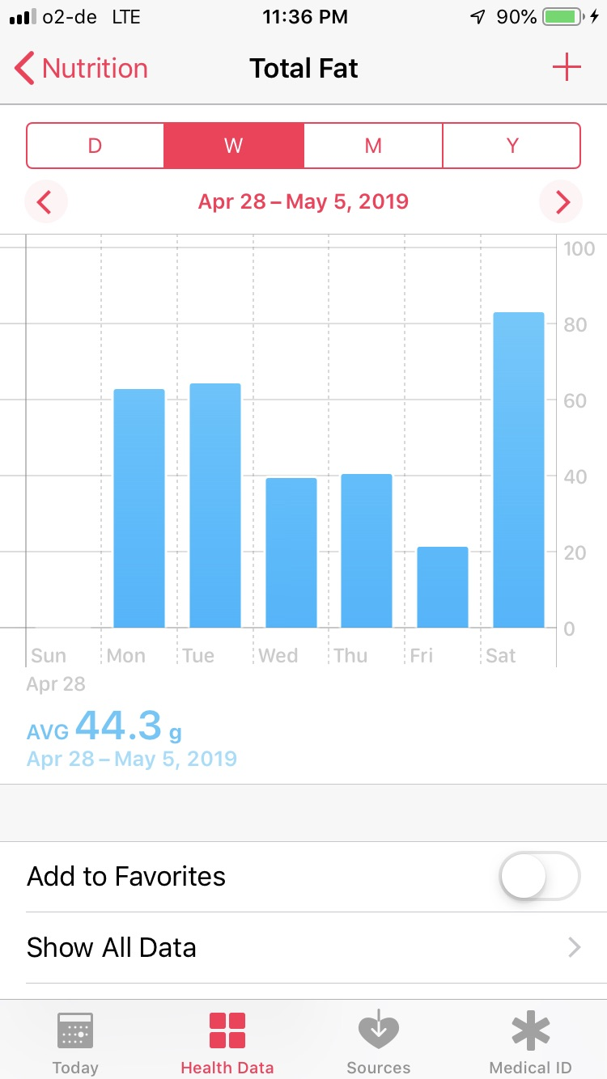
Empowered Health Consumer

Slide 43
Thank you
Tom Andriola
Vice President & CIO
University of California System
CIO, UC Health
Advisor, Calit2 at UCSD
EIR, CDHI at UCSF
tom.andriola@ucop.edu
@Andriola_UC

Slide 44
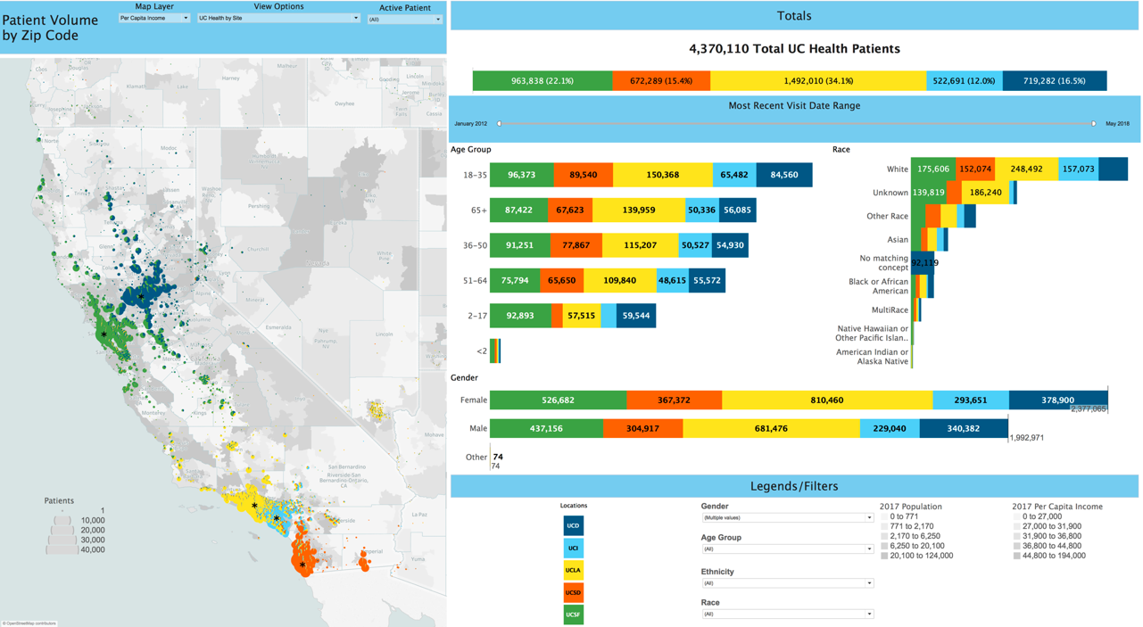
UC Health Patients (since January 2012)

Slide 45



Data Asset Management
Training Data Set
Raw Data
Validation
Enriched Data
Linking multi-modal data
Is the problem clinically relevant and doable?
De-identification
/Annotation
Data Management & Transformation
Can we get the data (internally & externally)?
Retrospective
Do we have the approvals to get the data? (IRB template, security template, governance?)
Environment to hold data
Go get the data
Data Production
Prospective (Point-of-Care)
Data Discovery Process
Confidential & Proprietary ©2017 The Regents of the University of California, UCSF Center for Digital Health Innovation . All Rights Reserved.

Slide 46
California has the challenges of a nation
California (CA) has 40 million citizens (2019)
If CA separate nation, it would be the world’s #5-#7 largest economy
70% of USA's fruits and 33% vegetables grown in the state
Diversity: 38% Hispanic, 38% White-European, 14% Asian, 6% African
Challenges with unemployment, under-employment, poverty rate, foreclosure rate, and uninsured population
    CA makes up about 12% of the total USA population but has ~25% of the country's homeless people.
USA leader in alternative energy sources, e.g., gasoline €1.14 per litre

Slide 47
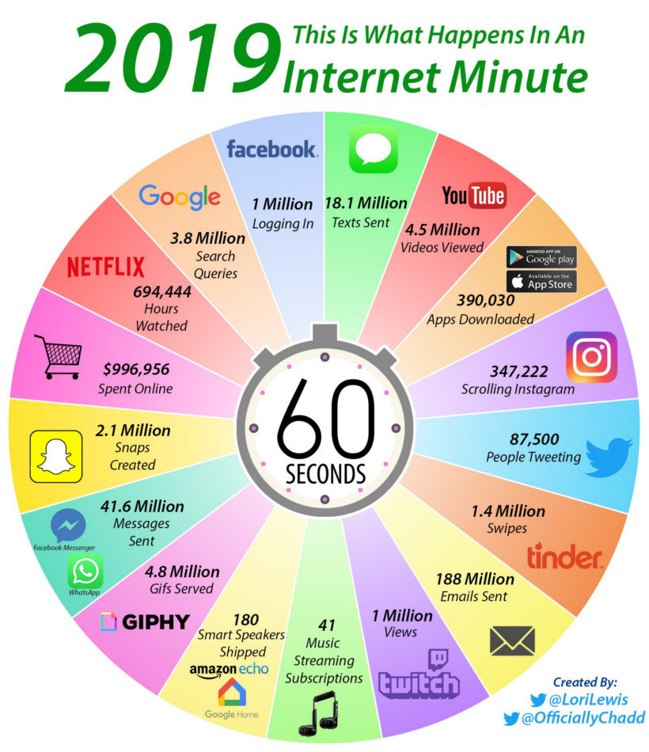

Slide 48
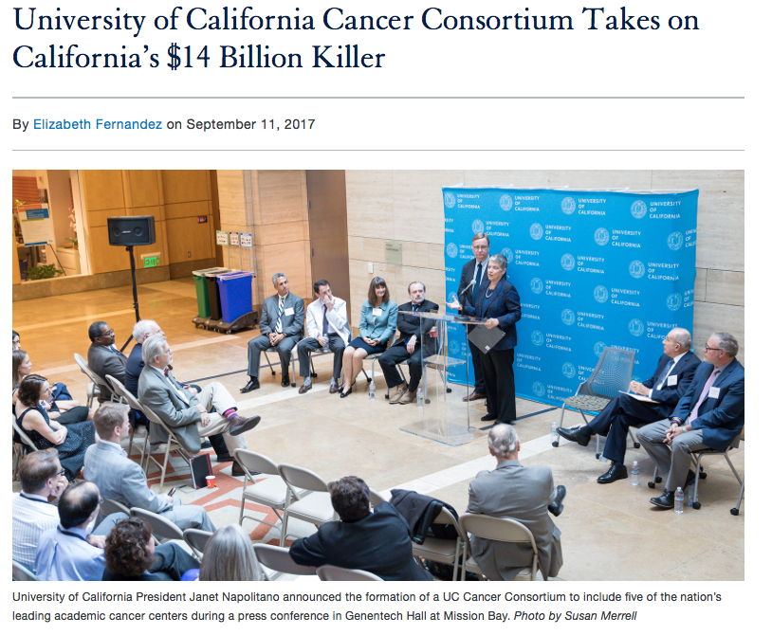

Slide 49
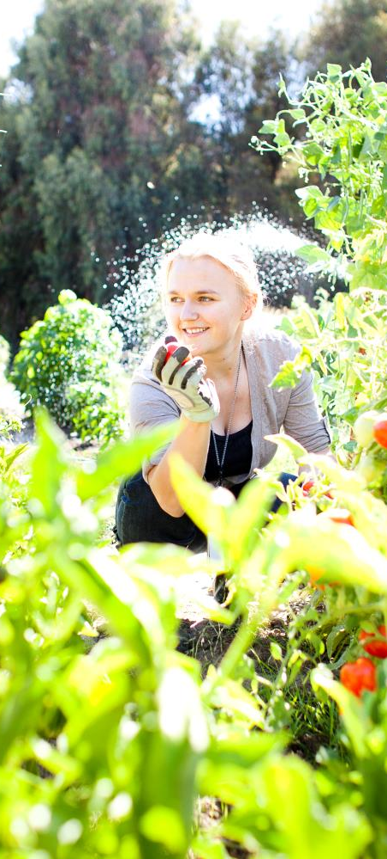
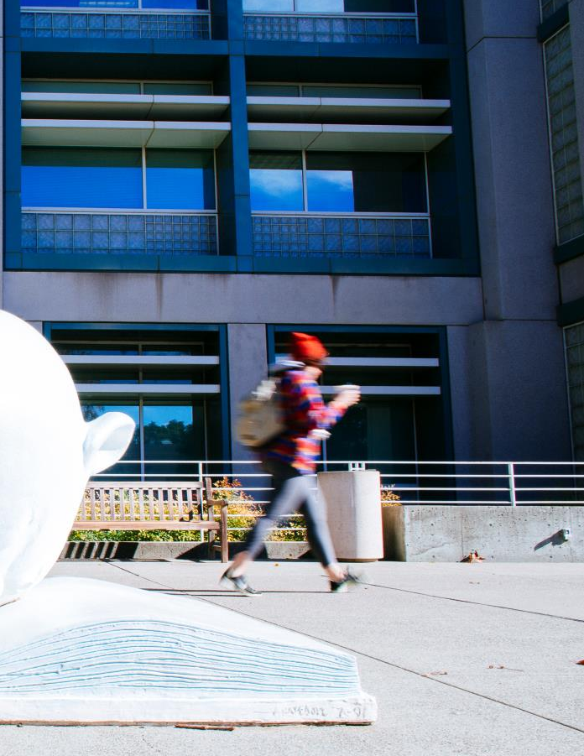
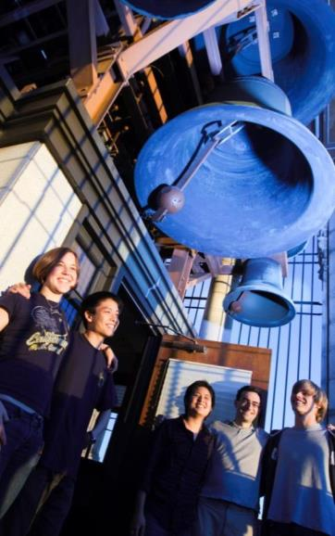

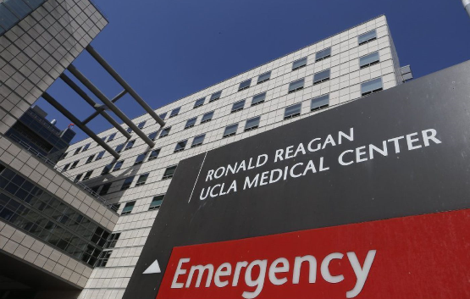
At UC, we do amazing things every day

Slide 50
Survival after return of the Genomic Test Result
Colorectal – 28 patients
Lung – 22 patients
Pancreas – 19 patients
Prostate – 12 patients

Slide 51
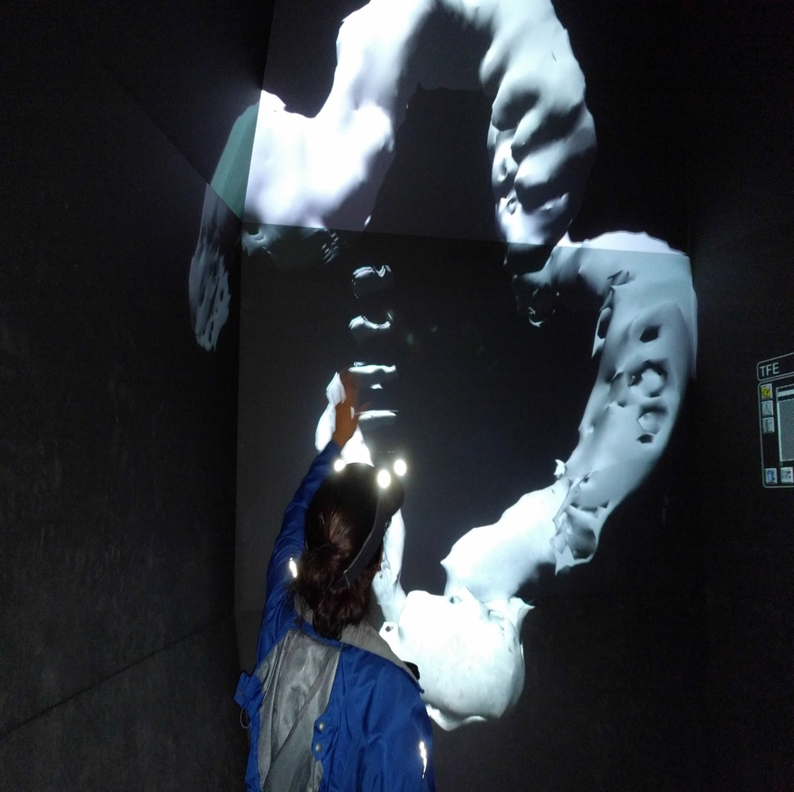
Innovation through “uncommon collaborations” that have potential to feed transformation and NBC
The fusion of
Data / human indexing
Computer visualization
Virtual/Augmented reality
Machine learning
For pre-surgical planning

Slide 52


is not just an asset
is a currency
Every
creates data
Transformation
across boundaries

Slide 53
Create, capture, and better analyze data from various sources
• Better identify and create new therapies and treatment options
• Identify at Identify at Identify at -risk patients and risk patients and intervene earlier
• Move to a value-based, outcome based, outcome -based model of reimbursement
• Improve access to care for all

Slide 54
Food Science & Tech
• Challenge 1: Develop High-Quality, Nutritious Foods Produced and Distributed in a Sustainable Manner to Meet the Needs and Demands of a Diverse Consumer Population
o We need research to improve our understanding of food and nutrient metabolism and their relationship to diet and health.
• Challenge 2: Protect the Integrity and Safety of the Global Food Supply Chain
• Omics in food connect to health – and more broadly multi-modal data platforms working with diverse data from the health system will allow consumers to manage
o Omics in food is opening doors to development of improved bioactive absorption and delivery systems, and better colors and flavors, to name just a few of the applications

Slide 55
California Innovation Ecosystem
Talent
Ideas
Technical
Talent
Scientific
Insight
Insight:
Government, Educational Institutions, and Industry (the ‘triple helix’) all play critical roles in an innovation ecosystem.
Representation from all are necessary for a healthy startup innovation ecosystem.
Entrepreneurial /
Business Talent
Market /
Application Insight
Community
Access to Capital
Commercial Partners
Go-to-Market /
Supply-Chain
Facilities /
Infrastructure
Government
& Policy
Resources
Collaborators
© 2018 Insight & Execution
used with permission

Slide 56
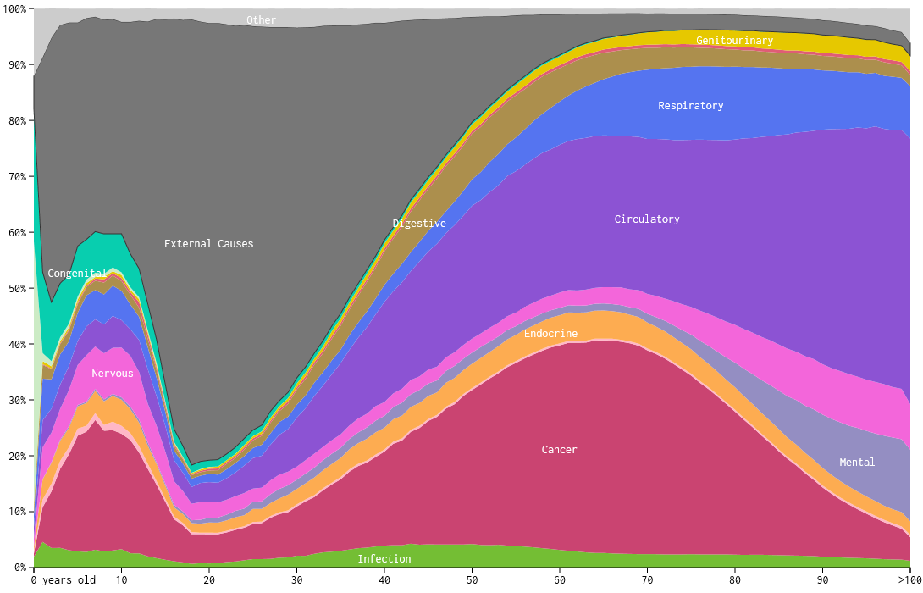

Slide 57
UC is an important engine for California
Research excellence
  USD $5.5B sponsored research per year
  61 noble laureates
  UC produces more patents than any other US university, averaging nearly five (5) new inventions every day
Economic mobility
  42% UC undergraduate students are first-generation attendees
  45% CA low-income residents received Pell Grants to attend UC
Economic growth
  511 active startups generating revenue $21B (2018)
  Direct jobs from these companies: 18,265

Slide 58
UC multi-discipline expertise . . .
Data Science
Clinical & Scientific
Expertise
Food as
Therapy
Enhanced, Longitudinal Patient/Consumer Data
Workflow
integration
Informatics
EHR Integration
Policy and Regulatory

Slide 59
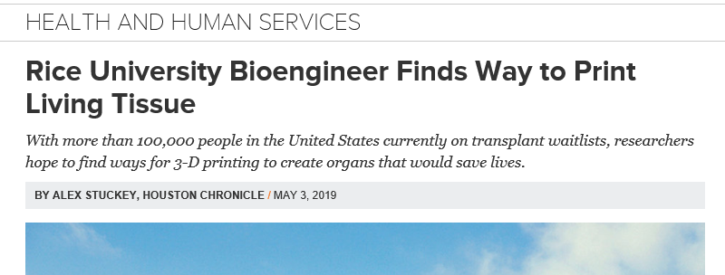

Slide 60
What we are about
UC Davis and UC San Francisco have joined together to create and deploy the most comprehensive program in the world designed specifically to quantify the use of “Food as Therapy.”
Only by combining the attributes and scale of one of the world's premier health sciences universities with one of the world's premier food science universities can the ultimate goal of understanding the ability of food to deter, prevent, and treat disease states be realized. In addition to leveraging the partnership's unique expertise towards a paradigm changing goal, we also can integrate commercial stakeholders and new business models to effect populations of people in their daily lives.
By design, the intent of “Food as Therapy” is not only fundamental research that leverages the strengths of each institution but also the ability to deliver and scale these discoveries for the betterment of all mankind.

Slide 61

Resulting in new offerings
Food as therapy will require a multi-disciplinary research and development process of applying scientific and clinical expertise to enhanced data in a computational environment to create, validate, and commercialize:
Consumer specific digital fingerprints
Personalized health predictions and trajectories
Insights into the impact of food on health trajectories
Commercialization of nutritive models
Decision support tools and user interfaces for consumers and, potentially, providers

Slide 62

The value of collaborating with UC
Multi-campus, multidisciplinary team of basic scientists and researchers, clinicians, data scientists, and forward-thinking business professionals
Use of enhanced data to uncover insights into impacting health trajectories
Highly scalable discovery and validation platform that is not discipline or domain specific
Experience working with commercial partners and collaborators
62

Slide 63
Scientific and clinical expertise
Food Science
World class food science capability
Long standing relationships with Food & Ag industries
Successful track record of IP generation and tech transfer
Health Science
Globally recognized brand for excellence in health, medicine & patient care
Long history of collaboration with industry
Unique innovation & commercialization approach (CDHI Smarter Health)

Slide 64
Leveraging enhanced data
Clinical
Lifestyle
Biological
Nutrition
Preference
Psycho-
Social
Genomic
Socio-
economic

Slide 65




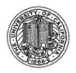



Utilizing a multi-dimensional platform
Priorities & Development Roadmap
Enhanced Data
Advanced Computation
Discovery & Validation
Deployed & Tested
Commercialization & Distribution
Deployment
Implementation & Pre-market
Testing
65

Slide 66

Customized commercialization process
Phase 1
Scientific POC
Phase 2
Pre-Clinical POC
Phase 3
Clinical Validation
Phase 1a: Research POC
Phase 1b: Technical Validation
UC
Full Training Set
Extended testing set
Clinical Setting
Partial annotated data
Complete training data per tech requirements
Commercial Entity (CE)
UCSF trained
CE initiates data ingestion with sample images
Rebuild and validate in third-party environment
UCSF provides new clinical data that CE can use to validate the outcome of the CNN.
Blinded workflow validation/
Full clinical trial
66
Notes:
Estimated Time: 20 min

Slide 67
Here are the seven digital health unicorns from 2018:
1. Peloton (connected indoor fitness cycles): $4.1 billion
2. 23andMe (direct-to-consumer genetic testing): $2.5 billion
3. Tempus (genomics platform for molecular and clinical data): $2 billion
4. Zocdoc (online platform for scheduling appointments with providers): $2 billion
5. HeartFlow (non-invasive coronary artery disease detection): $1.5 billion
6. Proteus (ingestible and wearable sensors for medication tracking): $1.5 billion
7. Butterfly (handheld ultrasound and smartphone app): $1.2 billion

