Slide 1
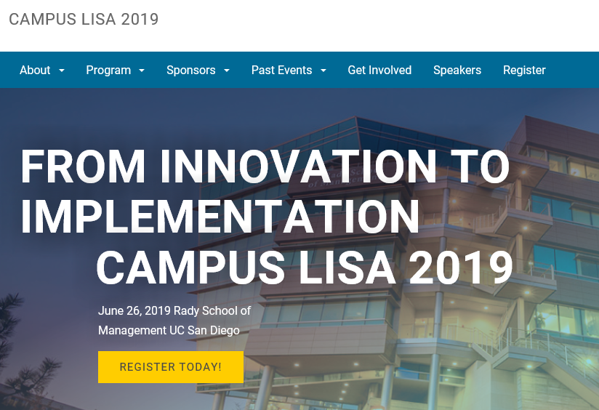

Tom Andriola
Vice President & CIO
University of California System
CIO, UC Health
Advisor, Calit2 at UCSD
Advisor, CDHI at UCSF

Slide 2
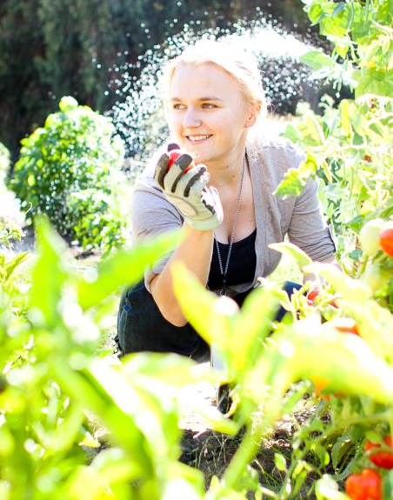
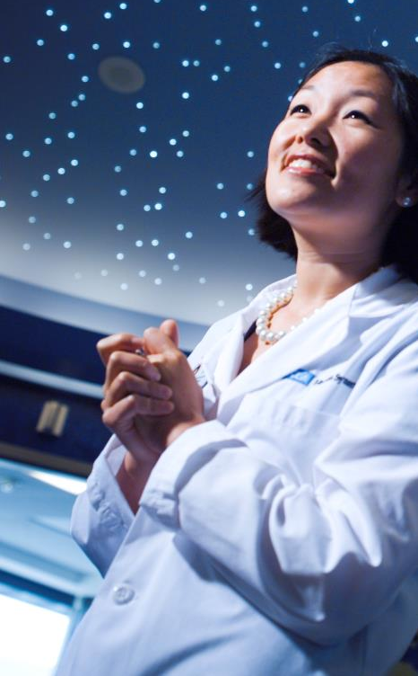
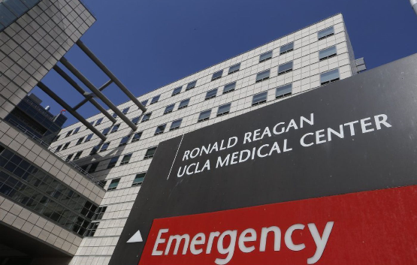
UC is an important engine for California
Food & Ag
Educational opportunity & economic mobility
Patient Care Research Education
Research excellence

Slide 3
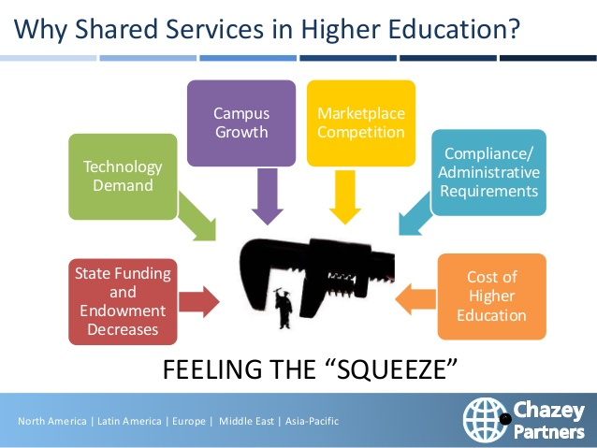
Pressures on Higher Education

Slide 4
How do we embrace this opportunity?

Slide 5
How do we not trip ourselves up?

Slide 6

“Image is Everything”
-- Andre Agassi
@Andriola_UC

Slide 7




“We’re IT: We put the NO in innovation”
@Andriola_UC

Slide 8

“This is what it feels like with the tools we get from you”
@Andriola_UC

Slide 9


From Innovation to Implementation
Universities may work by 1,000 flowers blooming,
but great organizations take innovation to scale.

Slide 10
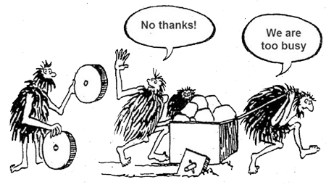
How do we not trip ourselves up?

Slide 11

This is the UC System

Slide 12
In genetics, you can’t change the gene, but you can alter the gene expression
We have much more in common than we have uniqueness
Community and Culture are more important than Strategy

Slide 15
Culture
&
Community
@Andriola_UC

Slide 16

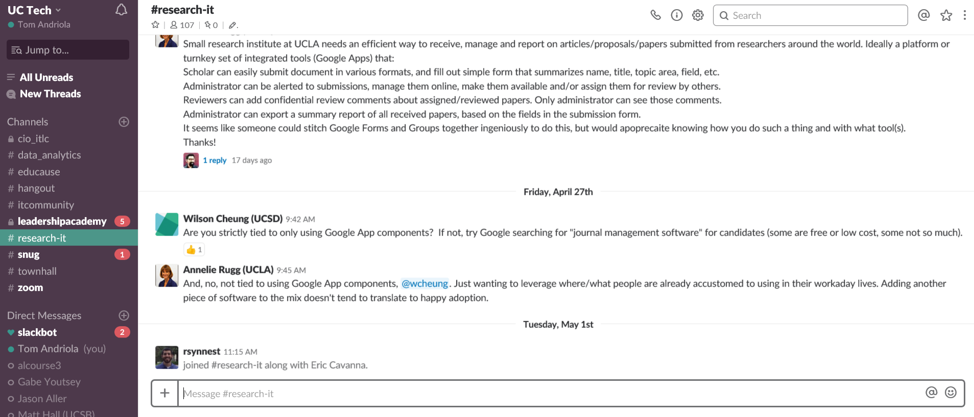
Community needs “connective fabric”
@Andriola_UC

Slide 17
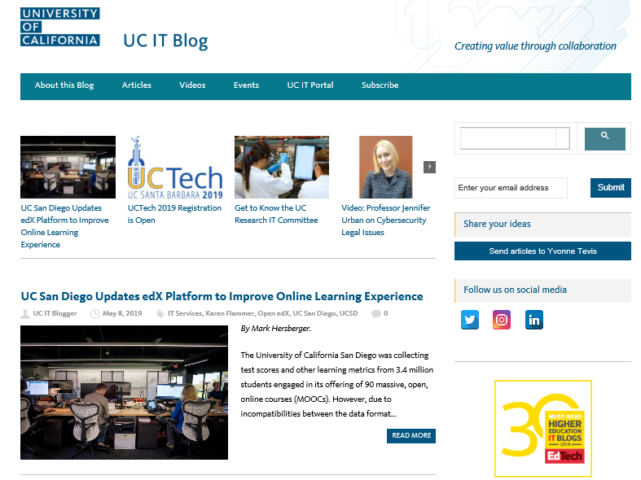
The Blog: “The Story of Us”
@Andriola_UC

Slide 18
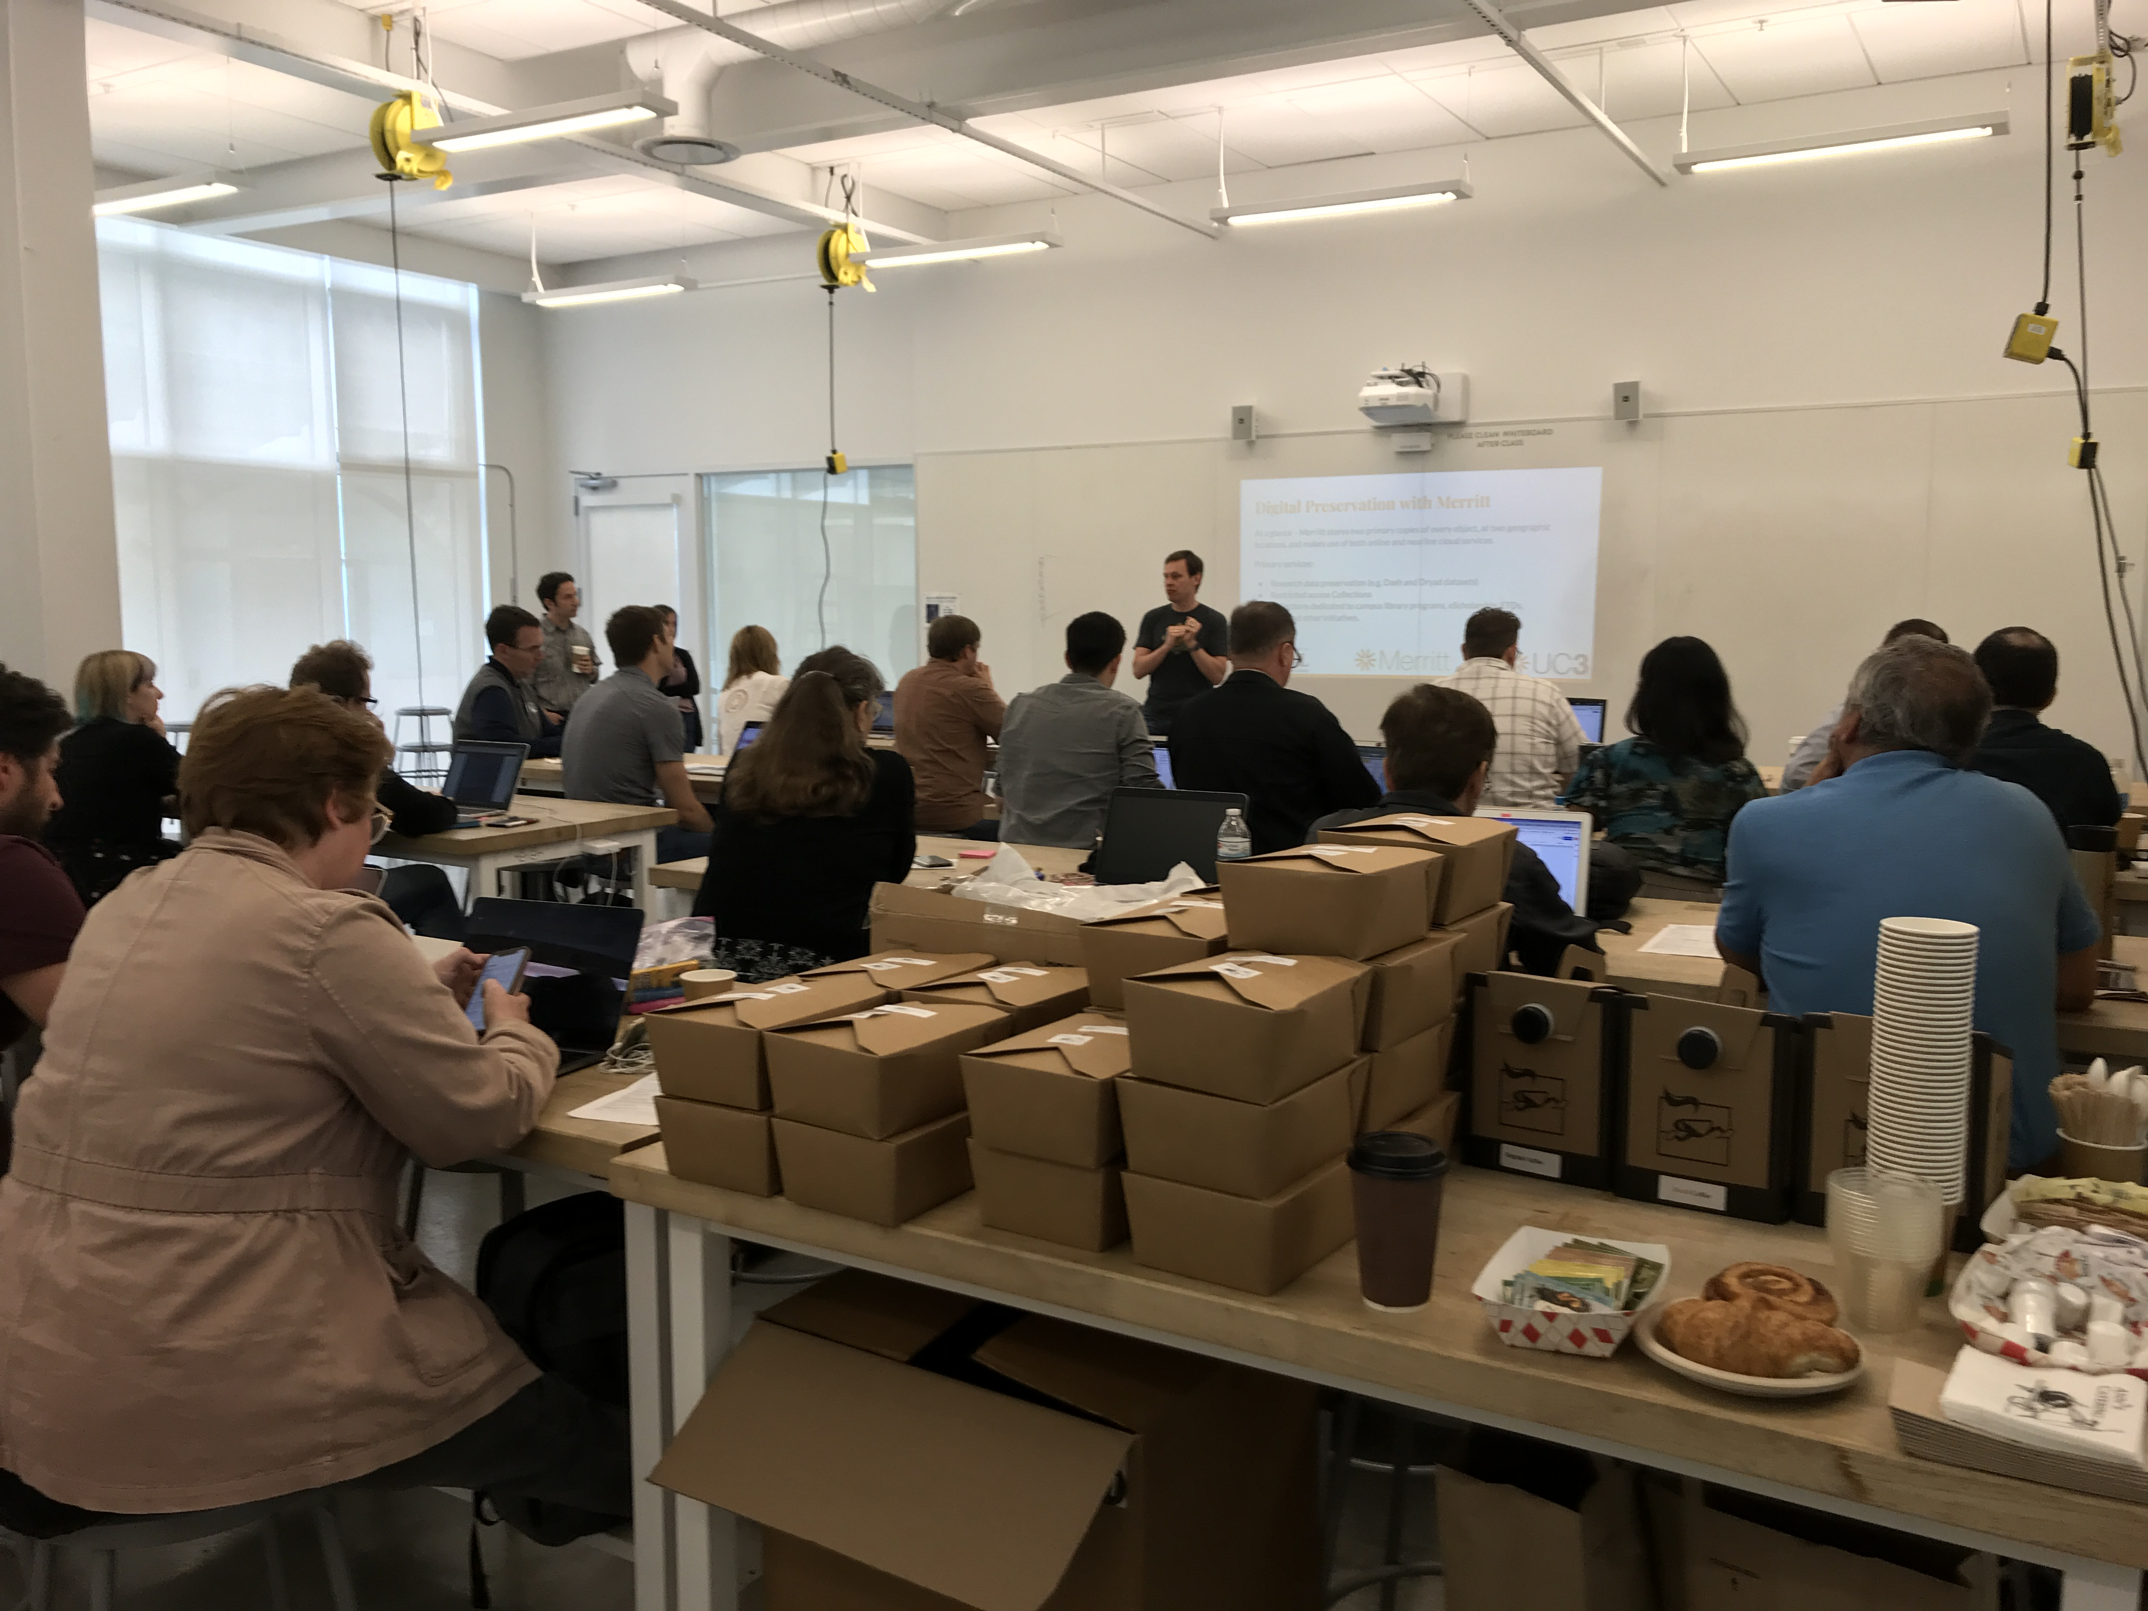
Community: Research Facilitation

Slide 19
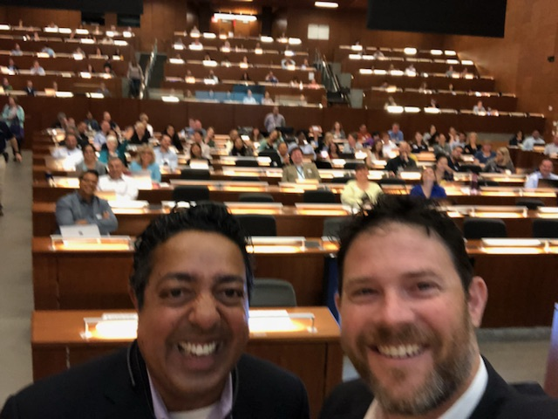
Community: UC Health Data Day

Slide 20
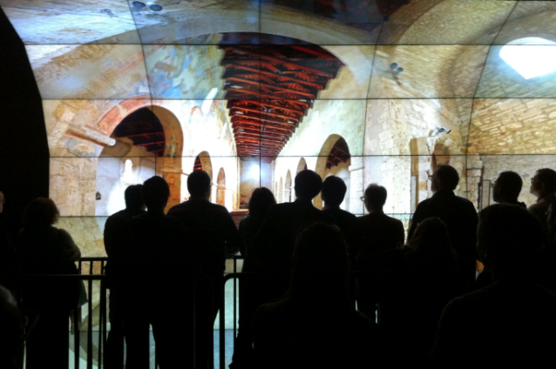
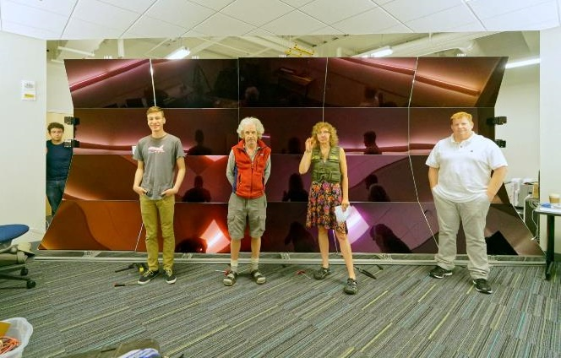
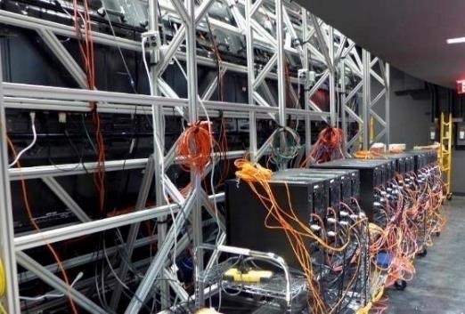
Reinforcing community & culture
Share, Copy, My Flavor, Go!
PRP
20x40G PRP-connected
40G FIONAs
WAVE@UC San Diego
WAVE @UC Merced

Slide 21

Innovation en mass
IT Employee
Innovator
Intrapreneur
Efficiency
Innovation
Value Creation
Entrepreneurship
@Andriola_UC

Slide 22
What you can do
  Continue to do a great job every day
  Make part of your job gaining time back for innovation (your definition)
  Leverage the collective intelligence of community
  Share key messages with others
  Help expand the community
  Keep innovating (trying stuff)
  Lean in, join in, make a difference

Slide 23


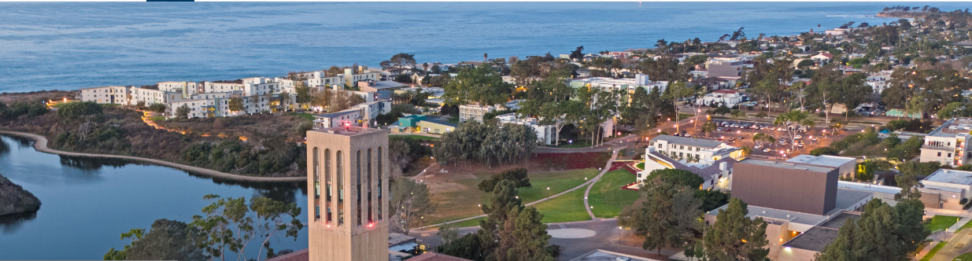
Community: Annual event

Slide 24
Thank you . . TEAM UC
Together
Everyone
Achieves
More

Slide 25
Cover in Questions/Discussion

Slide 26
UC is an important engine for California
Educational opportunity & economic mobility
  270,000+ students
  42% UC undergraduate students are first-generation attendees
  45% CA low-income residents received Pell Grants to attend UC
Research excellence and innovation catalyst
  USD $5.5B sponsored research per year
  61 noble laureates
  UC produces more patents than any other US university, averaging nearly five (5) new inventions every day
Healthcare
Food & Ag
  70% of USA's fruits and 33% vegetables grown in the state

Slide 27
What we’ve learned along the journey
  Community platform is fundamentally different
    Bottoms-up, not Top-down
    Invited, not Sold
    Organic, not Managed (messy, ambiguous)
  Workable strategies
    Let 1000 flowers bloom when required (divergent then convergent)
    Leveraging scale for value - bend curves and create inflection points
    Tip of the spear
    Collation of the willing
  Mentality
    No one is a smart as always
    Support “leading from the middle”
    Develop a time to value (TTV) mentality

Slide 28
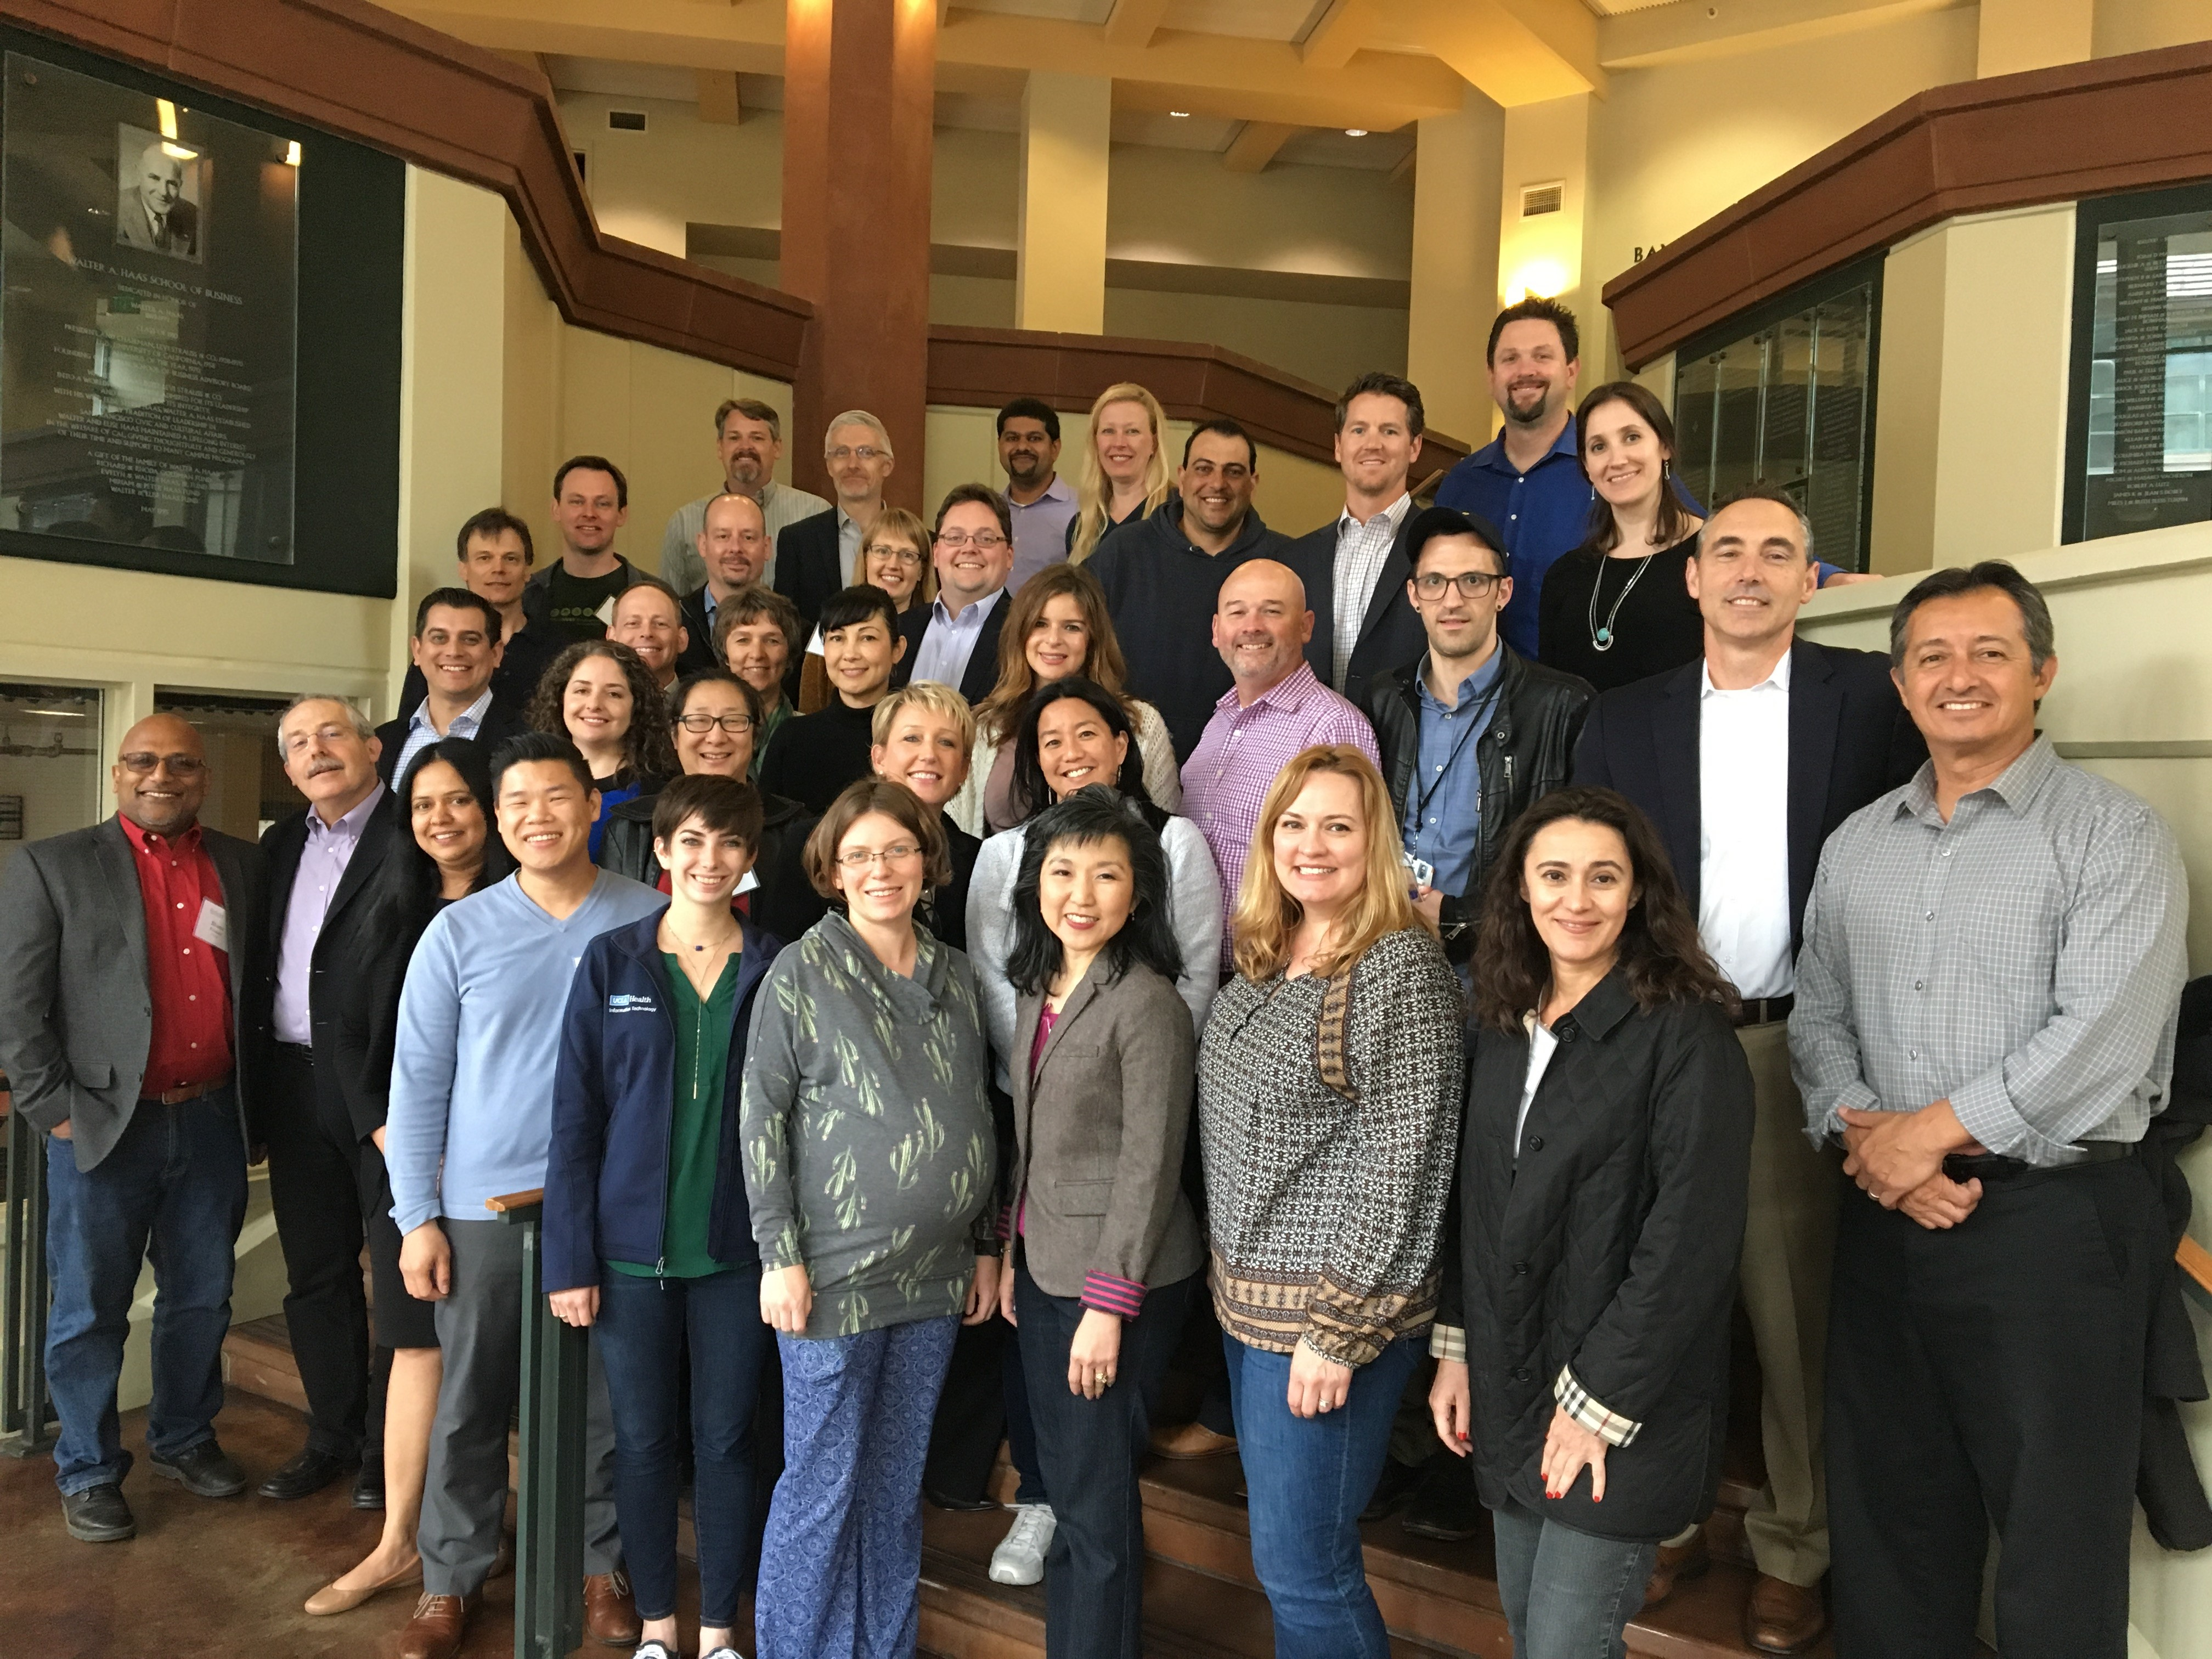
Community: UC IT Leadership Academy

Slide 29

Why communities work?
Like minded
Common struggle
Kindred spirits
Inclusive mindset
It really works
@Andriola_UC

Slide 30
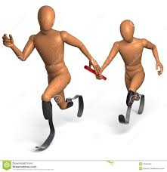
Building partnership

Slide 31
UC Mission
The privilege to:
- Create the Future
- Make People Better

Slide 32








UCITI Commercial Success Stories

Slide 33
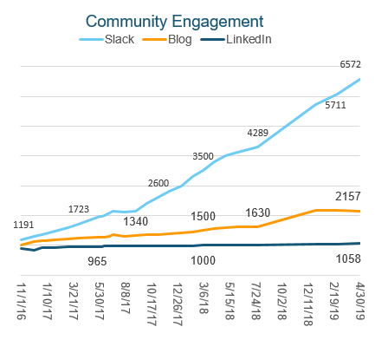
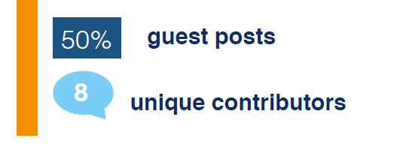
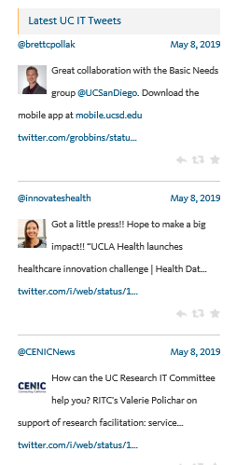
UC IT Community (8000 IT professionals)
Blog Contributors (April 2019)
@Andriola_UC

Slide 34
UCSD Stories, examples
UCSD campus: Robust and highly active governance related to enterprise systems, analytics, educational technology and research IT services
o UCSD campus: Community of Practice model with a full-time CoP facilitator/leader has worked very well in the business and student analytics areas
o UCSD-H: Broad deployment of over 600 dashboards with a federated analytics model to align with business goals (you are welcome to use the attached slide)
o UCSD community: Conversion of student health services to Epic EMR this summer to support population health and across the care continuum
UCSD working with UCM on The Cave

